Slide 1

Deployment and MLOps Creating Data-driven/ML applications Jeremy van Gorp
232189 Group: 2024-25d-fai2-adsai-group-nlp11(CV8)
Learning Log
Year 2
Block D
Group: https://github.com/BredaUniversityADSAI/2024-25d-fai2-adsai-group-nlp11.git
Assessment Rubric: https://github.com/JeremyvanGorp232189/2025_D/blob/d9a9db39da60cea5bb42ae12988fdab2de81984d/Assessment%20Rubric%20Y2D%202025%20final.xlsx
Group: https://github.com/BredaUniversityADSAI/2024-25d-fai2-adsai-group-nlp11.git
My own: https://github.com/JeremyvanGorp232189/2025_D.git

Slide 2

How To Use
This Template
As a student at Breda University of Applied Sciences studying to become a professional, you are required to provide evidence that demonstrates your professional learning and growth during the block. This template is intended to provide you with a well-structured and organised format for doing this effectively. Keep in mind that certain competencies may require you to update your evidence every week, and others may have only be relevant during a particular week or two.
With the evidence you present here teachers should get a clear and comprehensive overview of your progress, how you’ve engaged with feedback, as well as your general attitude and performance as a student and as an aspiring professional developer.
Note that number and size of text boxes and how they are organized on each slide may be modified as needed. It is up to you to decide what layout is most effective for the content you are providing. You may also add slides if needed, but try to be as economical as possible, i.e. quality over quantity. Focus on the things that are the most significant and meaningful.
You are also free to stylise this template to improve the graphic design and visual appeal, but please remember its purpose: to provide evidence of your progress towards becoming a professional developer. Changes should only enhance and extend the information, and may never subtract. I.e. do not delete anything or change the order of things. If in doubt, seek approval from your teachers!

Slide 3
Learning Log
Structure
Section A - My Plan Must be completed in week 1
Your plan describes your goals for the block. Starting with where you are right now, where do you want to be at the end of the block? I.e. what role(s) will you take responsibility for, and how will you demonstrate progress relevant to the ILOs for this block? What tasks and deliverables are best aligned with your role and the project brief?
Section B - ILO’s Must be completed in week 8, but should be updated regularly
This is where you link your evidence to each of the Intended Learning Outcomes of this block.
Section C - Weekly Log Must be updated every week
This is simply a log (journal) of what you do each day, and what you learn from it. It is your responsibility to update this regularly and frequently. Be sure to include working links to any specific evidence you are referencing (and make sure that you share your docs with the teaching team). Note: some of the required information may be captured in production documents such as your work log or peer reviews.
In such cases, you simply need to provide links to those artifacts and may include any explanatory comment or reflection you feel is appropriate.
(Some reflection is almost always a good idea as it provides the foundation for Section C.)
Section D - Reflection Must be completed in week 8
Summative reflection on your progress during the block including a critical assessment of everything you did and learned during the block. This is a comprehensive review of everything recorded in Section B, evaluated against the goals and planning laid out in Section A.
Section A
Starting this block
Goals
Section B
ILO section
Week log section
Section C
Block reflection

Slide 4
Section A
A
Goal Setting
Notes:
MUST BE UPDATED EVERY WEEK
This is simply a log (journal) of what you do each day, and what you learn from it. It is your responsibility to update this regularly and frequently. Be sure to include working links to any specific evidence you are referencing (and make sure that you share your docs with the teaching team). Note: some of the required information may be captured in production documents such as your work log or peer reviews.
In such cases, you simply need to provide links to those artifacts and may include any explanatory comment or reflection you feel is appropriate.
(Some reflection is almost always a good idea as it provides the foundation for Section C.)

Slide 5
A
Where am I starting?
1/2
Feedback from previous assessment - Previous block’s grade
8.6
Excellent work. You provided the client with a solid solution.
Some minor issues with documentation.
Be careful of spreading your work over multiple documents.
One well-structured document is more readable than two.
Some structural issues in the documentation.
Some issues with individual deliverables like feedback and annotations.
My interpretation / key takeaways
Consolidate work into one clear and structured document instead of splitting it.
Improve documentation structure and formatting.
Pay more attention to how feedback and annotations are delivered.
My solution for the client was strong — this is a foundation I can build on.
Keep up the high quality but refine the way I present and document the work.
Notes:
Copy and paste the feedback from the previous block’s assessment into the text box.
Copy and paste the bullet points you listed on the “Lessons Learned” page in section C of your last block’s log.
Compare the grade you gave yourself with the grade you received, and reevaluate or restate your feeling on your current level of progress.

Slide 6
A
What is my plan?
2/2
What I learned last block - Previous block’s grade
8.6
– How to deliver a technically solid solution for the client
– That clear and concise documentation is crucial
– Feedback and annotations must be structured and complete
My current level of progress
– Off to a strong start this sprint – More focus on consolidating work into one clear document – Feedback moments are better planned and implemented
Links Block C
Group: https://github.com/BredaUniversityADSAI/2024-25c-fai2-adsai-group-group23.git
Self: BredaUniversityADSAI/2024-25c-fai2-adsai-JeremyvanGorp232189: 2024-25c-fai2-adsai-JeremyvanGorp232189 created by GitHub Classroom
Notes:
Copy and paste the feedback from the previous block’s assessment into the text box.
Copy and paste the bullet points you listed on the “Lessons Learned” page in section C of your last block’s log.
Compare the grade you gave yourself with the grade you received, and reevaluate or restate your feeling on your current level of progress.

Slide 7
A
What are my goals?
1/1
S | Specific: Be specific when determining your goal. The more specific the better. Putting a real figure to your goal helps make it measurable. When specific and measurable your subconscious mind cannot override your goals, they become achievable.
M | Measurable: This where you define a measurable and meaningful goal. It’s important to be able to track your progress. Without meaningful and measurable goals which you can track it’s easy to lose heart and focus.
A | Achievable: Choosing realistic and short-term goals helps them be more achievable. Long-term goals can be larger and take more time to achieve. Planning smaller short-term goals as steps to larger long-term goals assists in achieving them.
R | Relevant: Each goal you set must be in line with your core values and in harmony with what YOU want out of life. Contradictions in values and goals leads to frustration and loss of motivation. Designing your goals with the expectation of your personal success.
T | Time-Bound: Setting a time limit on achieving a goal makes it measurable. When a goal is measurable you can SEE your progress and support your motivation and commitment. Giving your goal a time limit assists you in holding yourself accountable to its completion.
E | Evaluate: By evaluating your goals on a regular basis you will be much more likely to achieve them. It is easy to forget about long-term goals if they are not revisited from time to time. This also helps you assess if the goal you are working on remains in line with your core values and helps you measure your progress.
R | Readjust: Readjustments occur when goals are determined, through re-evaluation, to be misaligned with your values or long-term goals. This is especially helpful when you have been unable to achieve a goal in the time limits you set. This gives you the opportunity to modify your approach and increase your chances of success.
I am taking responsibility for (if multiple add in percentages)
I am taking responsibility for (100%)
Personal goal: Ultra 160 km preparation – 50%
Professional goal: Completing Udemy sales course – 50%
Personal and professional development goals
Personal Goal – Ultra 160 km Preparation (50%)
Specific: Prepare for a 160 km ultramarathon by following a structured running plan Measurable: 7 sessions per week — 6 short runs (10 km) + 1 long run Achievable: Aligned with current fitness level; fits around academic workload Relevant: Develops discipline, endurance, and mental resilience Time-Bound: Reach peak condition by the end of this 10-week block Evaluate: Weekly tracking via Strava; log consistency and physical response Readjust: Switch to 5 short runs + 1 long run + 1 rest day if necessary
Notes:
Describe your goals for this block using the SMARTER method. Make sure they are clear, relevant, have a measurable outcome, and can be recorded. Consider how well do they align with the role(s) you wish to take, and with the requirements given in the project brief. Think about the objectives you plan to choose, or that are mandated by the project. Are there any competencies that you need to focus on?
For each goal, find concrete examples of tasks you expect to undertake that will demonstrate this within the project for the block. Make sure the plan has an outcome that can be tracked and assessed. Make sure you have a clearly stated target for each goal. If you are unsure of how to demonstrate something, ask for help from your teachers.

Slide 8
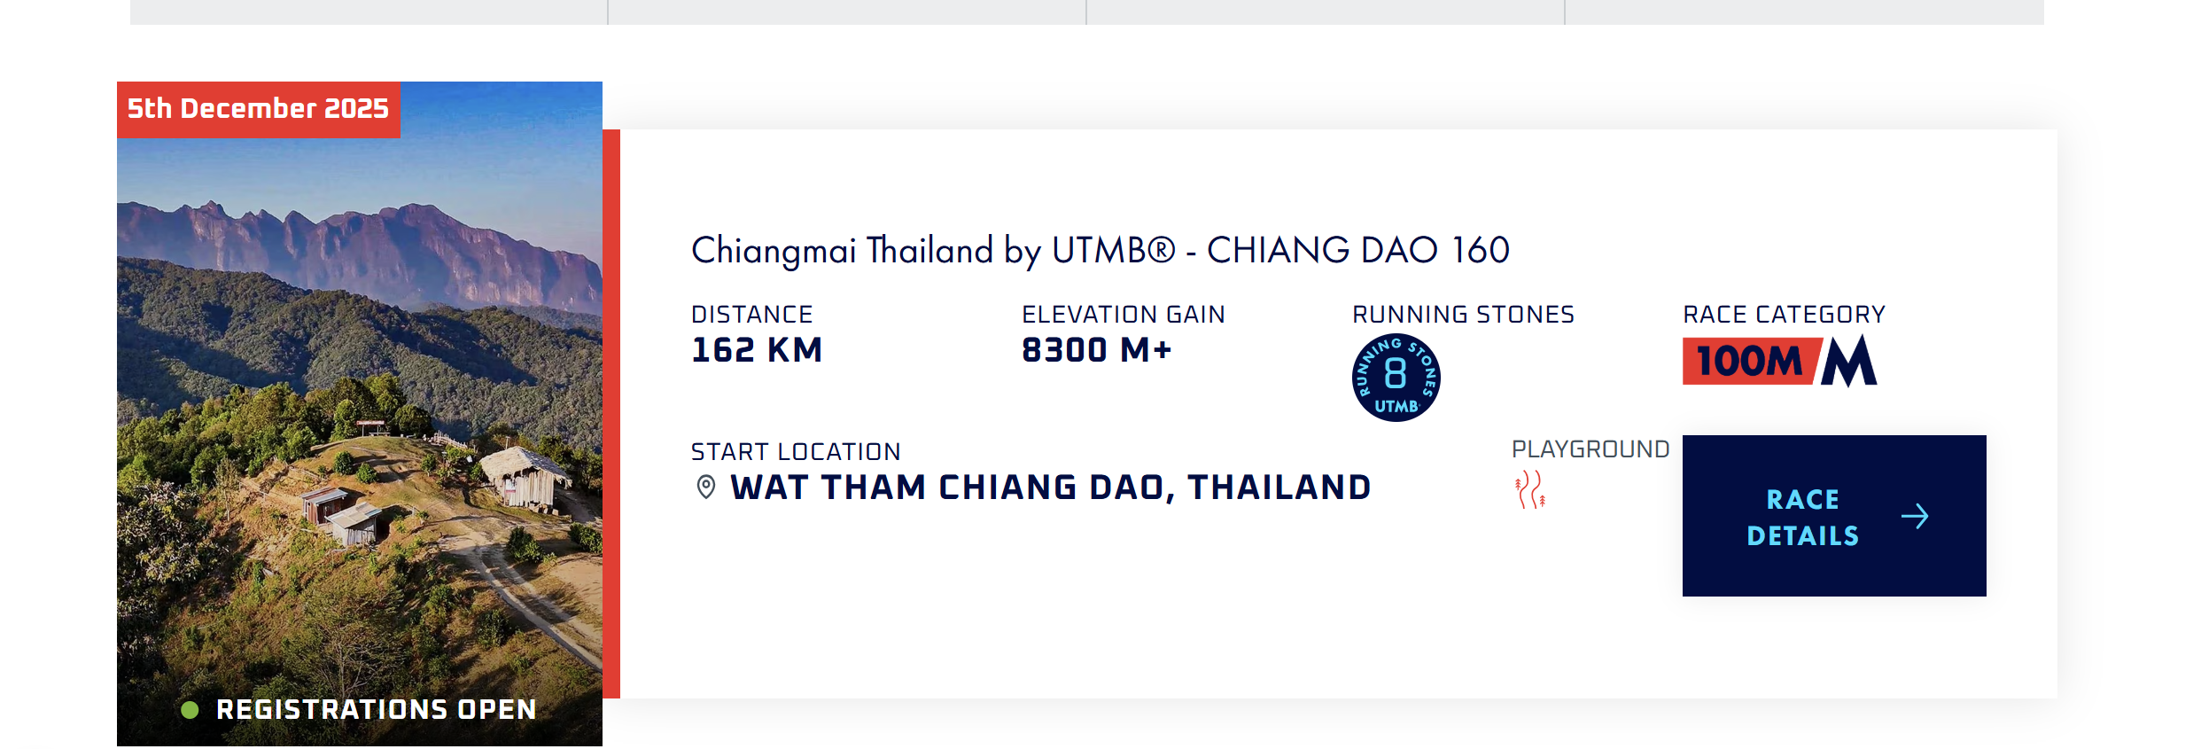
A
What are my goals?
1/1
S | Specific: Be specific when determining your goal. The more specific the better. Putting a real figure to your goal helps make it measurable. When specific and measurable your subconscious mind cannot override your goals, they become achievable.
M | Measurable: This where you define a measurable and meaningful goal. It’s important to be able to track your progress. Without meaningful and measurable goals which you can track it’s easy to lose heart and focus.
A | Achievable: Choosing realistic and short-term goals helps them be more achievable. Long-term goals can be larger and take more time to achieve. Planning smaller short-term goals as steps to larger long-term goals assists in achieving them.
R | Relevant: Each goal you set must be in line with your core values and in harmony with what YOU want out of life. Contradictions in values and goals leads to frustration and loss of motivation. Designing your goals with the expectation of your personal success.
T | Time-Bound: Setting a time limit on achieving a goal makes it measurable. When a goal is measurable you can SEE your progress and support your motivation and commitment. Giving your goal a time limit assists you in holding yourself accountable to its completion.
E | Evaluate: By evaluating your goals on a regular basis you will be much more likely to achieve them. It is easy to forget about long-term goals if they are not revisited from time to time. This also helps you assess if the goal you are working on remains in line with your core values and helps you measure your progress.
R | Readjust: Readjustments occur when goals are determined, through re-evaluation, to be misaligned with your values or long-term goals. This is especially helpful when you have been unable to achieve a goal in the time limits you set. This gives you the opportunity to modify your approach and increase your chances of success.
In order to test myself, I signed up for this race of 100 miles in Thailand.
Notes:
Describe your goals for this block using the SMARTER method. Make sure they are clear, relevant, have a measurable outcome, and can be recorded. Consider how well do they align with the role(s) you wish to take, and with the requirements given in the project brief. Think about the objectives you plan to choose, or that are mandated by the project. Are there any competencies that you need to focus on?
For each goal, find concrete examples of tasks you expect to undertake that will demonstrate this within the project for the block. Make sure the plan has an outcome that can be tracked and assessed. Make sure you have a clearly stated target for each goal. If you are unsure of how to demonstrate something, ask for help from your teachers.

Slide 9
A
What are my goals?
1/1
S | Specific: Be specific when determining your goal. The more specific the better. Putting a real figure to your goal helps make it measurable. When specific and measurable your subconscious mind cannot override your goals, they become achievable.
M | Measurable: This where you define a measurable and meaningful goal. It’s important to be able to track your progress. Without meaningful and measurable goals which you can track it’s easy to lose heart and focus.
A | Achievable: Choosing realistic and short-term goals helps them be more achievable. Long-term goals can be larger and take more time to achieve. Planning smaller short-term goals as steps to larger long-term goals assists in achieving them.
R | Relevant: Each goal you set must be in line with your core values and in harmony with what YOU want out of life. Contradictions in values and goals leads to frustration and loss of motivation. Designing your goals with the expectation of your personal success.
T | Time-Bound: Setting a time limit on achieving a goal makes it measurable. When a goal is measurable you can SEE your progress and support your motivation and commitment. Giving your goal a time limit assists you in holding yourself accountable to its completion.
E | Evaluate: By evaluating your goals on a regular basis you will be much more likely to achieve them. It is easy to forget about long-term goals if they are not revisited from time to time. This also helps you assess if the goal you are working on remains in line with your core values and helps you measure your progress.
R | Readjust: Readjustments occur when goals are determined, through re-evaluation, to be misaligned with your values or long-term goals. This is especially helpful when you have been unable to achieve a goal in the time limits you set. This gives you the opportunity to modify your approach and increase your chances of success.
I am taking responsibility for (if multiple add in percentages)
I am taking responsibility for (100%)
Personal goal: Ultra 160 km preparation – 50%
Professional goal: Completing Udemy sales course – 50%
Personal and professional development goals
Professional Goal – Sales Course via Udemy (50%)
Specific: Complete a sales skills course to improve my client communication and conversion ability Measurable: Study 4 hours per week, progress logged in weekly planner Achievable: Integrated into my weekly routine during low-focus hours Relevant: Directly supports future work in sales, consulting, or entrepreneurship Time-Bound: Finish the course and apply learned skills within the current block Evaluate: Reflect weekly on insights; apply concepts in roleplays or deliverables Readjust: If scheduling becomes inconsistent, switch to 2 × 2-hour focused blocks per week
Notes:
Describe your goals for this block using the SMARTER method. Make sure they are clear, relevant, have a measurable outcome, and can be recorded. Consider how well do they align with the role(s) you wish to take, and with the requirements given in the project brief. Think about the objectives you plan to choose, or that are mandated by the project. Are there any competencies that you need to focus on?
For each goal, find concrete examples of tasks you expect to undertake that will demonstrate this within the project for the block. Make sure the plan has an outcome that can be tracked and assessed. Make sure you have a clearly stated target for each goal. If you are unsure of how to demonstrate something, ask for help from your teachers.

Slide 10

A
What are my goals?
1/1
S | Specific: Be specific when determining your goal. The more specific the better. Putting a real figure to your goal helps make it measurable. When specific and measurable your subconscious mind cannot override your goals, they become achievable.
M | Measurable: This where you define a measurable and meaningful goal. It’s important to be able to track your progress. Without meaningful and measurable goals which you can track it’s easy to lose heart and focus.
A | Achievable: Choosing realistic and short-term goals helps them be more achievable. Long-term goals can be larger and take more time to achieve. Planning smaller short-term goals as steps to larger long-term goals assists in achieving them.
R | Relevant: Each goal you set must be in line with your core values and in harmony with what YOU want out of life. Contradictions in values and goals leads to frustration and loss of motivation. Designing your goals with the expectation of your personal success.
T | Time-Bound: Setting a time limit on achieving a goal makes it measurable. When a goal is measurable you can SEE your progress and support your motivation and commitment. Giving your goal a time limit assists you in holding yourself accountable to its completion.
E | Evaluate: By evaluating your goals on a regular basis you will be much more likely to achieve them. It is easy to forget about long-term goals if they are not revisited from time to time. This also helps you assess if the goal you are working on remains in line with your core values and helps you measure your progress.
R | Readjust: Readjustments occur when goals are determined, through re-evaluation, to be misaligned with your values or long-term goals. This is especially helpful when you have been unable to achieve a goal in the time limits you set. This gives you the opportunity to modify your approach and increase your chances of success.
Notes:
Describe your goals for this block using the SMARTER method. Make sure they are clear, relevant, have a measurable outcome, and can be recorded. Consider how well do they align with the role(s) you wish to take, and with the requirements given in the project brief. Think about the objectives you plan to choose, or that are mandated by the project. Are there any competencies that you need to focus on?
For each goal, find concrete examples of tasks you expect to undertake that will demonstrate this within the project for the block. Make sure the plan has an outcome that can be tracked and assessed. Make sure you have a clearly stated target for each goal. If you are unsure of how to demonstrate something, ask for help from your teachers.

Slide 11
Section B
B
Progress Log
Notes:
MUST BE UPDATED EVERY WEEK
This is simply a log (journal) of what you do each day, and what you learn from it. It is your responsibility to update this regularly and frequently. Be sure to include working links to any specific evidence you are referencing (and make sure that you share your docs with the teaching team). Note: some of the required information may be captured in production documents such as your work log or peer reviews.
In such cases, you simply need to provide links to those artifacts and may include any explanatory comment or reflection you feel is appropriate.
(Some reflection is almost always a good idea as it provides the foundation for Section C.)

Slide 12
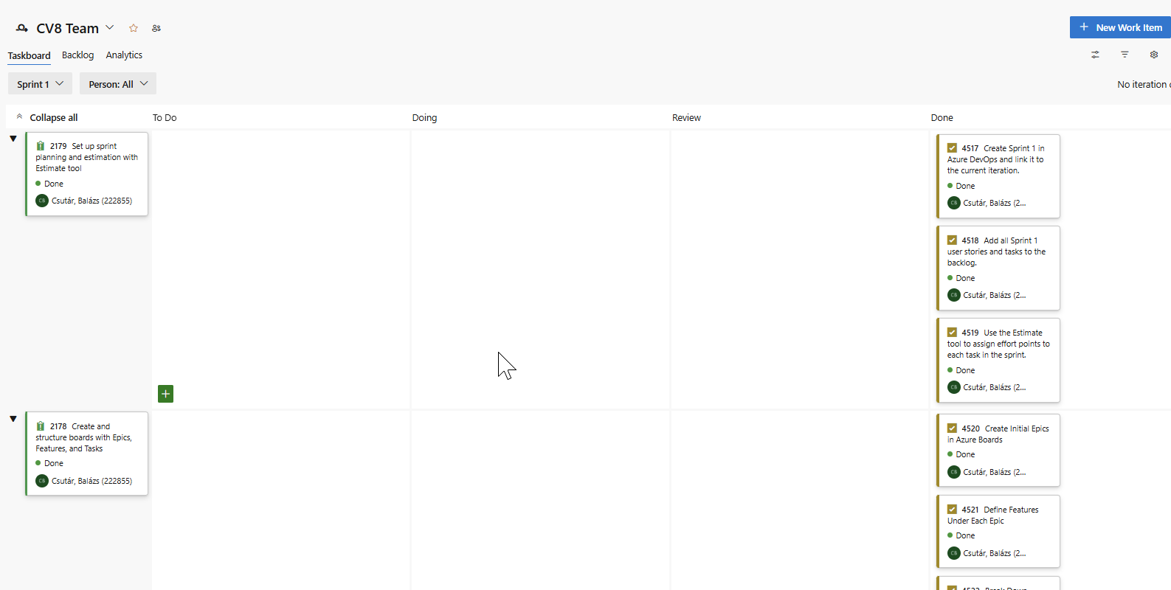
1
Week 1 - Log
1/2
What did you do?
Reflection
What goal(s) did you set for this week?
Define the project scope and MVP.
Set up GitHub and Azure DevOps.
Plan team roles and sprint structure.
What have you actually been able to do?
Created the GitHub repo and base folder structure.
Added user stories and tasks in Azure Boards.
Defined package layout and first sprint scope.
Showcase the evidence of your progress (production artifacts, short descriptions: links: pictures: animated gifs, etc.).
How did the week go?
Productive and well-coordinated.
Good progress on setup.
Strong alignment within the team.
What went well?
Clear task division.
Fast DevOps and repo setup.
Strong communication in meetings.
What didn’t go so well?
Some confusion around model handover.
Time lost aligning deliverables.
Lack of clarity on technical split at first.
What did you learn?
Preparation prevents later issues.
Good tooling boosts productivity.
MVP clarity is critical from week 1.
What could be added as an Action point looking forward to next week?
Finalize and test MVP inference code.
Implement unit tests and CI setup.
Align expectations with the Product Owner.

Slide 13
1
Week 1 - Feedback
2/2
Team, individual, peer, workshop feedback
Joey van Angelen (232997)
Good start to the block. Clear communication during planning and a proactive attitude in setting up Azure Boards. Would be great to see a bit more initiative in technical discussions during upcoming sprints.
Click for feedback delivery techniques!

Slide 14
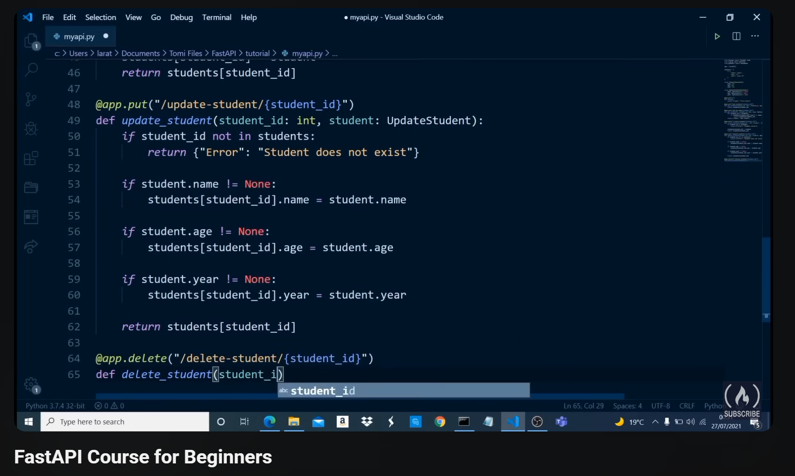
2
Week 2 - Log
1/2
What did you do?
Reflection
What goal(s) did you set for this week?
Build the first version of the emotion inference package.
Set up automated unit testing.
Create initial FastAPI endpoint for inference.
What have you actually been able to do?
Finished and committed the first working version of the inference module.
Added pytest-based unit tests for core functions.
Deployed a working FastAPI endpoint locally with test inputs.
Showcase the evidence of your progress
Followed a Fast-API course to gain more knowledge:
How did the week go?
Intense but productive; major milestone completed.
What went well?
Clear collaboration and role ownership.
Fast turnaround from code to deployment.
Tests caught early bugs efficiently.
What didn’t go so well?
Initial confusion with path handling in Docker.
Delayed feedback loop due to long test cycles.
Documentation lagged slightly behind development.
What did you learn?
Importance of fast feedback during testing.
How to expose model inference via FastAPI.
Unit tests are crucial before integration.
What could be added as an Action point looking forward to next week?
Set up CI pipeline for testing and formatting.
Begin writing production-level docs with Sphinx.
Align API structure with frontend integration plan.

Slide 15
2
Week 2 - Feedback
2/2
Team, individual, peer, workshop feedback
Joey van Angelen (232997)
Nice progress on connecting the backend to the frontend. The first version of the FastAPI UI works well. Just make sure the layout stays clean and that user input handling is clear for the end user.
Click for feedback delivery techniques!

Slide 16
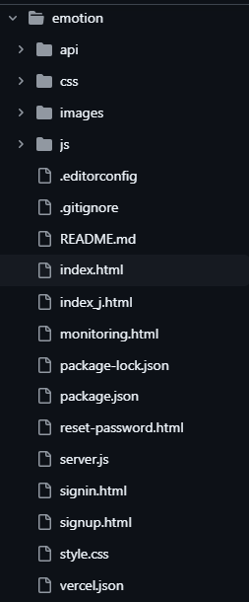
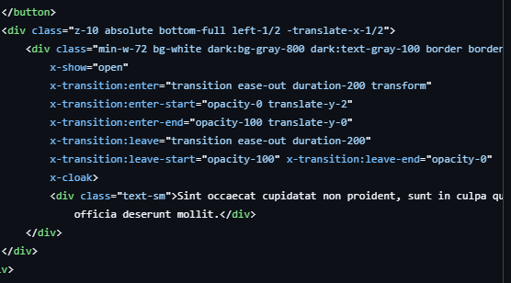
3
Week 3 - Log
1/2
What did you do?
Reflection
What goal(s) did you set for this week?
Start building the frontend dashboard.
Connect FastAPI backend with the frontend.
Style the UI using Tailwind CSS for a clean layout.
What have you actually been able to do?
Built the base layout of the dashboard (tabs, navbar, results panel).
Established API connection and displayed dummy results.
Styled key components using Tailwind and adjusted responsiveness.
Showcase the evidence of your progress
How did the week go?
It was a productive and focused sprint, with visible UI progress.
What went well?
Frontend structure and API integration worked without major issues.
Tailwind improved speed of visual development.
Clear separation between backend and frontend logic.
What didn’t go so well?
Some layout inconsistencies on smaller screens.
Needed more time for testing mobile responsiveness.
Debugging async API calls slowed down progress.
What did you learn?
How to structure a component-based UI efficiently.
Linking frontend to FastAPI with fetch/axios.
Importance of early mobile-first testing.
What could be added as an Action point looking forward to next week?
Add loading states and error handling in the UI.
Start integrating live classification results.
Polish design and add transitions for better UX.

Slide 17
3
Week 3 - Feedback
2/2
Team, individual, peer, workshop feedback
Soma Gergo (233650)
Nice work on supporting the frontend API integration this week. You gave clear input during testing and helped track down a bug in the async call. Maybe next time we can align earlier on expected frontend outputs.
Click for feedback delivery techniques!

Slide 18
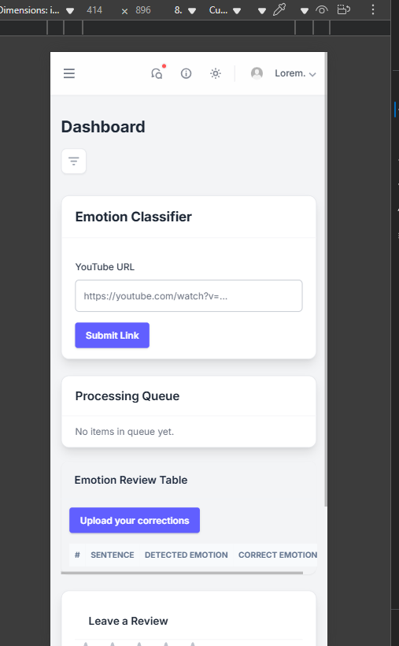
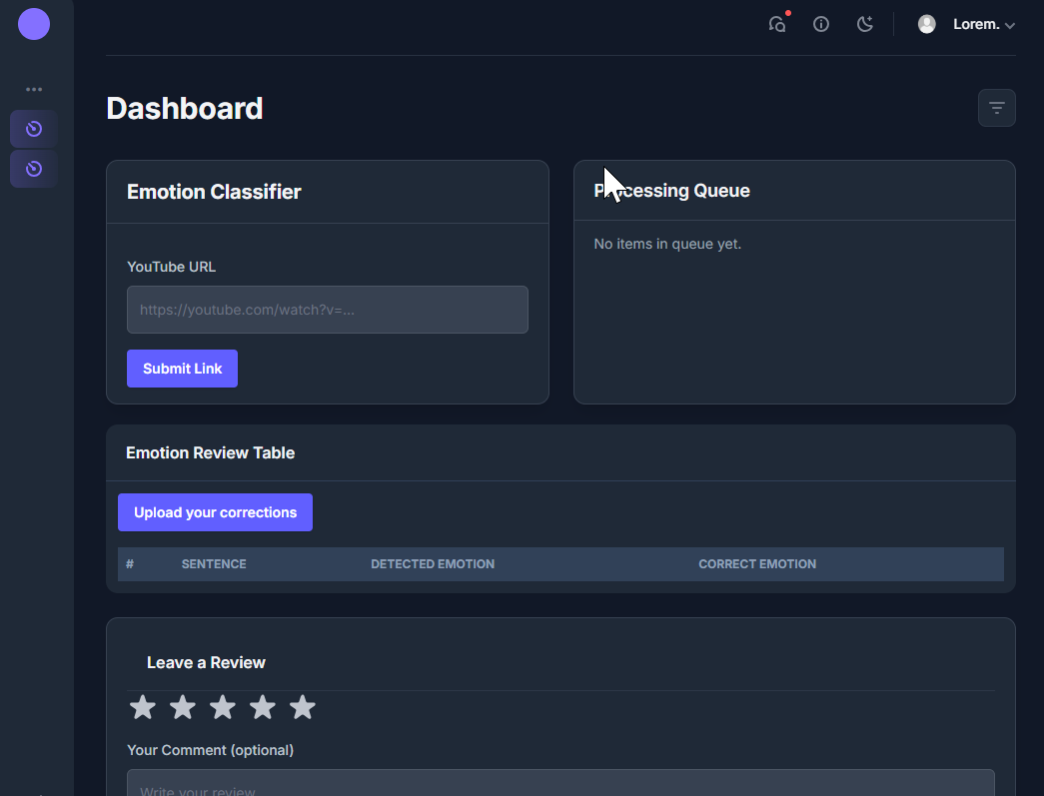
4
Week 4 - Log
1/2
What did you do?
Reflection
What goal(s) did you set for this week?
Improve frontend styling and responsiveness.
Integrate real-time emotion output from backend.
Prepare demo-ready UI version.
What have you actually been able to do?
Applied advanced Tailwind styling across all components.
Successfully connected live inference results to the frontend.
Created scrollable results area and improved user flow.
Showcase the evidence of your progress
How did the week go?
Strong week with major progress on integration and UI polish.
What went well?
Frontend and backend are now fully connected.
Layout improvements made the dashboard more user-friendly.
Feedback from team was positive on visual clarity.
What didn’t go so well?
Chart rendering was buggy on first attempt.
Some CSS bugs on smaller screens.
Minor delay syncing with backend updates.
What did you learn?
How to map backend JSON output into visual components.
Value of consistent class naming and layout planning.
Real-time data can cause layout shifts if not handled carefully.
What could be added as an Action point looking forward to next week?
Add animations/transitions for smoother UX.
Finalize mobile layout.
Prepare for end-of-block demo and feedback session.

Slide 19
4
Week 4 - Feedback
2/2
Team, individual, peer, workshop feedback
Soma Gergo (233650)
The live frontend looks much better this week. The new layout is clean and the connection to the backend works well. Maybe add a loading animation or status message when the backend is still processing.
Click for feedback delivery techniques!

Slide 20
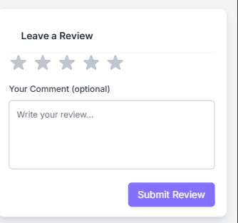
5
Week 5 - Log
1/2
What did you do?
Reflection
What goal(s) did you set for this week?
Finalize the frontend UI for the demo.
Add polish: loading states, transitions, and basic error handling.
Sync with backend team to ensure live deployment works smoothly.
What have you actually been able to do?
Added animations, improved responsiveness, and refined layout.
Implemented loading indicators and fallback messages.
Integrated deployed backend into the frontend for full demo test.
Showcase the evidence of your progress
How did the week go?
Strong progress and very close to final product. Confident going into demo.
What went well?
Frontend looks complete and feels smooth.
Good coordination with backend for live testing.
Demo version runs without blocking issues.
What didn’t go so well?
Some CORS/config issues during initial deployment.
Limited time left for deeper testing on mobile.
A few misalignments in backend payloads that needed quick fixes.
What did you learn?
How to refine UX with subtle transitions and states.
Importance of early deployment testing (not just local).
Small UI/UX details make a big difference in perceived quality.
What could be added as an Action point looking forward to next week?
Prepare for the demo day presentation and walkthrough.
Final bugfixes and polish based on feedback.
Reflect on peer contributions and fill in the peer review.

Slide 21
5
Week 5 - Feedback
2/2
Team, individual, peer, workshop feedback
Balazs Csutar (222855)
Your frontend is visually impressive and now connects well with the backend
Click for feedback delivery techniques!

Slide 22
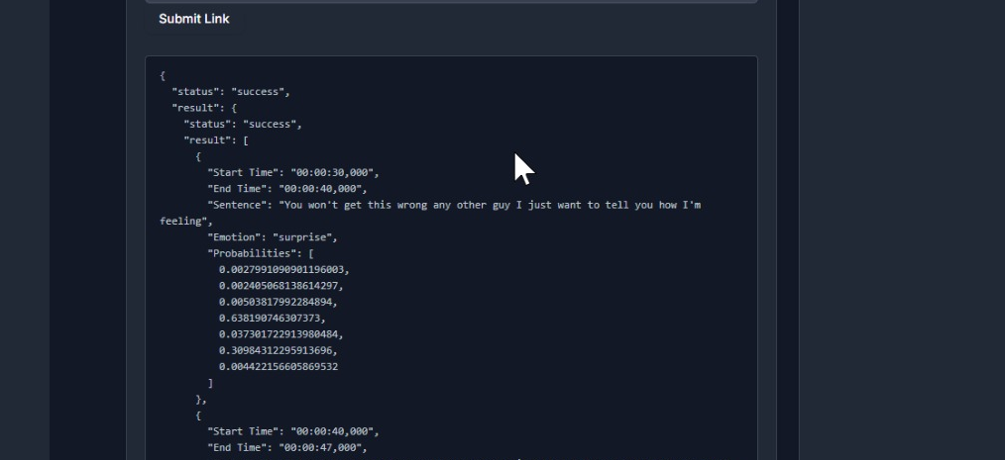
6
Week 6 - Log
1/2
What did you do?
Reflection
What goal(s) did you set for this week?
- Solve CORS issues between frontend and backend.
- Implement and validate unit tests for key backend functions.
- Prepare the app for full integration testing.
What have you actually been able to do?
- CORS errors fixed by adjusting FastAPI middleware and headers.
- Wrote and ran unit tests for API endpoints and emotion model.
- Validated test coverage and ensured backend stability.
Showcase the evidence of your progress
How did the week go?
Technically strong week — backend stability improved significantly.
What went well?
Fixing CORS unblocked frontend/backend communication.
Unit tests gave confidence in inference pipeline.
Test structure now allows faster debugging.
What didn’t go so well?
Some time lost debugging preflight OPTIONS requests.
Initial test setup needed multiple iterations to detect async errors.
Forgot to exclude some helper files from coverage at first.
What did you learn?
Proper CORS setup is essential in production apps.
Unit tests are not just for bugs, but for safe iteration.
Small test refactors make future work easier.
What could be added as an Action point looking forward to next week?
Set up integration tests across frontend and backend.
Add CI pipeline to automatically run tests on commit.
Clean up unused API routes and finalize documentation.

Slide 23
6
Week 6 - Feedback
2/2
Team, individual, peer, workshop feedback
Joey van Angelen (232997)
Thanks for jumping in on debugging the backend/frontend CORS issues. Your clear testing approach helped us quickly isolate the problem. It’s also great to see your frontend getting more refined every week.
ILO A – Self-awareness & Stress Management (3 pts) Jeremy showed strong emotional awareness and remained focused under pressure. Despite technical challenges, he managed his stress well and kept his planning consistent throughout the sprint.
Weekly Goal (Week 6): Improve emotional self-monitoring by sticking to my planning, managing sprint pressure, and maintaining mental clarity during debugging tasks.
Click for feedback delivery techniques!

Slide 24
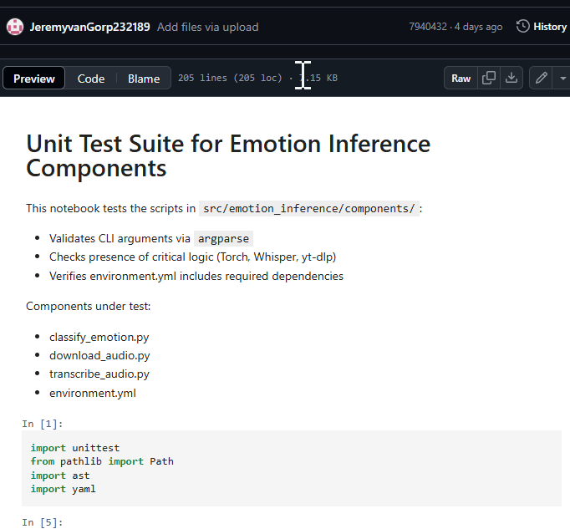
7
Week 7 - Log
1/2
What did you do?
Reflection
What goal(s) did you set for this week?
Support peers with API testing and debugging.
Finalize unit testing and improve test coverage.
Organize Azure DevOps dashboard for better sprint overview.
What have you actually been able to do?
Helped peers verify API connections and fix small issues.
Extended unit tests for backend functions and error cases.
Cleaned up Azure Board: clarified sprint tasks and priorities.
Showcase the evidence of your progress
How did the week go?
Helpful and collaborative; team support was the focus.
What went well?
API testing and feedback to peers saved them time.
Test structure is now more robust.
Azure board is clear and easier to follow.
What didn’t go so well?
Some tasks lacked clear ownership at the start of the week.
Test configuration needed more cleanup than expected.
Azure updates were done late due to other priorities.
What did you learn?
Supporting others strengthens the whole project.
Clean documentation and task breakdown prevent confusion.
Unit testing small edge cases adds big stability gains.
What could be added as an Action point looking forward to next week?
Final peer review and contribution overview.
Prepare personal input for demo + wrap-up.
Archive and document final board state for submission.

Slide 25
7
Week 7 - Feedback
2/2
Team, individual, peer, workshop feedback
Soma Gergo (233650)
You were very helpful this week in getting everyone over the finish line. Thanks for supporting with API testing and for helping improve the Azure Board.
ILO B – Empathy & Support for Others (3 pts) Jeremy actively supported Soma and the team by assisting with API testing and improving the Azure planning board. His help gave others breathing room in a high-pressure week and positively impacted team stress levels.
Weekly Goal (Week 7): Continue supporting peers when tasks overflow — by taking over technical work or co-testing — to reduce their pressure and improve emotional well-being across the team.
Click for feedback delivery techniques!

Slide 26
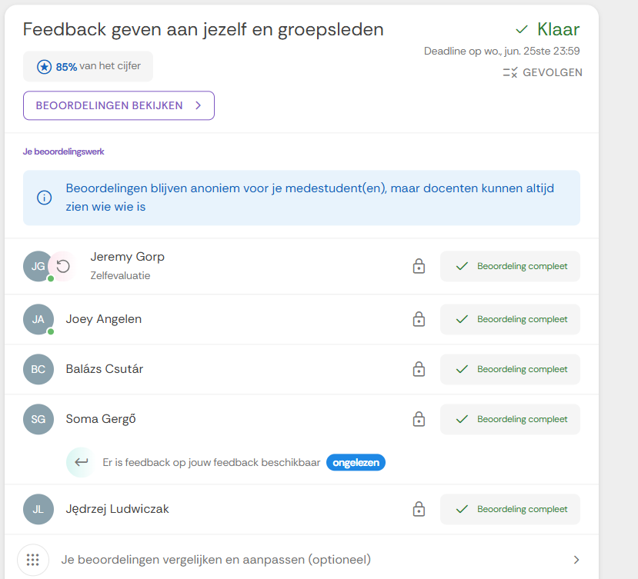
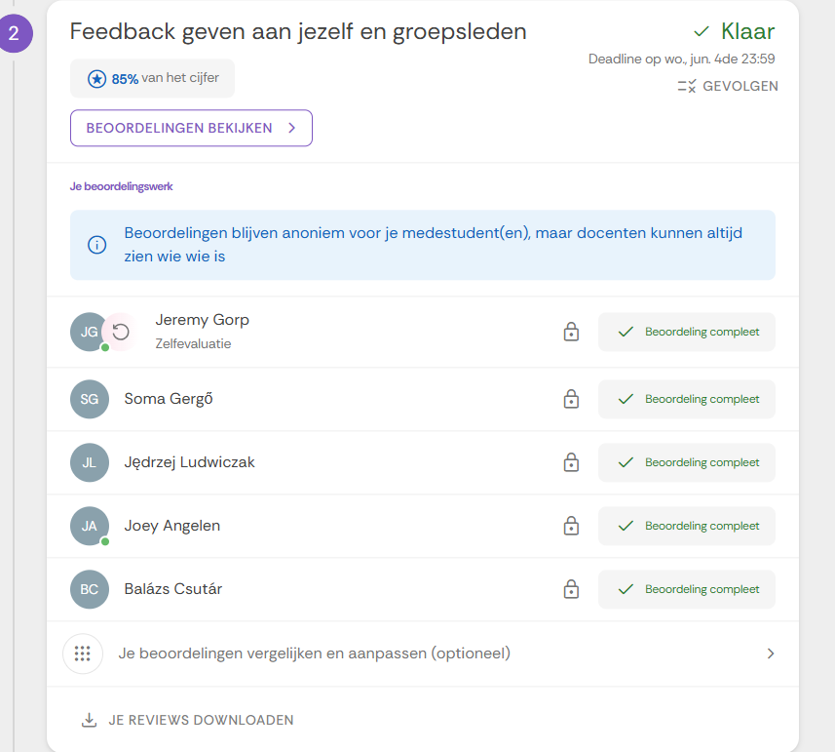
8
Week 8 - Log
1/2
What did you do?
Reflection
What goal(s) did you set for this week?
Finalize all project components for the deadline.
Perform full demo run and check integration.
Complete and submit documentation + peer reviews.
What have you actually been able to do?
Successfully ran the full demo and resolved last bugs.
Submitted all final deliverables, including logs and documentation.
Showcase the evidence of your progress
How did the week go?
Intense but satisfying — everything came together just in time.
What went well?
The demo was smooth and well-structured.
Documentation was complete and easy to follow.
Team worked well together under deadline pressure.
What didn’t go so well?
Some last-minute confusion on what exactly needed to be submitted.
A few merge conflicts in GitHub slowed us down.
What did you learn?
Finishing strong is about communication and coordination.
Clean project structure really matters at the end.
Peer review gives valuable insight into individual contributions.
What could be added as an Action point looking forward to next week?
Take time to reflect and archive all important resources.
Use peer feedback to improve future team collaboration.

Slide 27
8
Week 8 - Feedback
2/2
Team, individual, peer, workshop feedback
Joey van Angelen (232997)
Great job this week supporting others with testing and debugging. Your help with unit testing and setting up the Azure dashboard made our sprint planning much smoother. It's clear you're taking ownership of the frontend and bringing structure to the process.
ILO C – Driving Team Progress & Emotional Balance (4 pts) Over the course of Weeks 6–8, Jeremy has evolved into a key contributor who not only maintains his own planning and emotional stability but also improves team dynamics. By consistently supporting Joey, Soma, and others, and helping structure our Azure sprint board, he ensures both progress and emotional clarity for the whole team.
Weekly Goal (Week 8): Consolidate my personal sprint achievements while enabling others to perform better — by guiding frontend tasks, structuring our sprint board, and promoting a calm and collaborative team environment.
Click for feedback delivery techniques!

Slide 28
Section C
C
Progress
Intended Learning Outcomes
Notes:
MUST BE COMPLETED IN WEEK 8, BUT SHOULD BE UPDATED REGULARLY
This is where you link your evidence to each of the Intended Learning Outcomes of this block.

Slide 29
ILO 1
Professional Practice
The student can collaborate (internationally) in multidisciplinary teams with different levels of knowledge in the field of data use and applications. They can set up and execute projects in collaboration with stakeholders and team members. They can act as a sounding board in discussions with team members, customers, users and experts. They strive for a good balance between input of their own vision and additional expertise of others. They are able to lead a team.

Slide 30
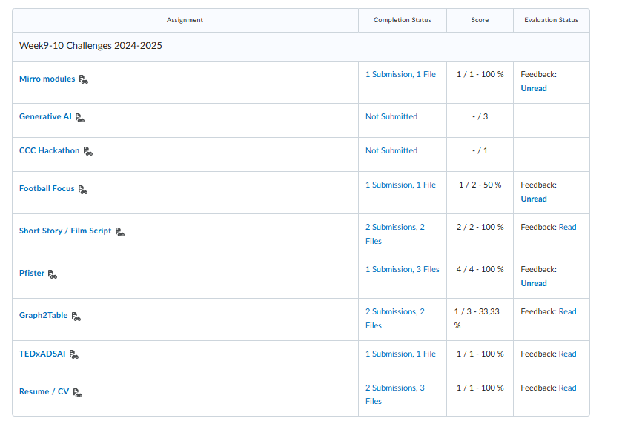
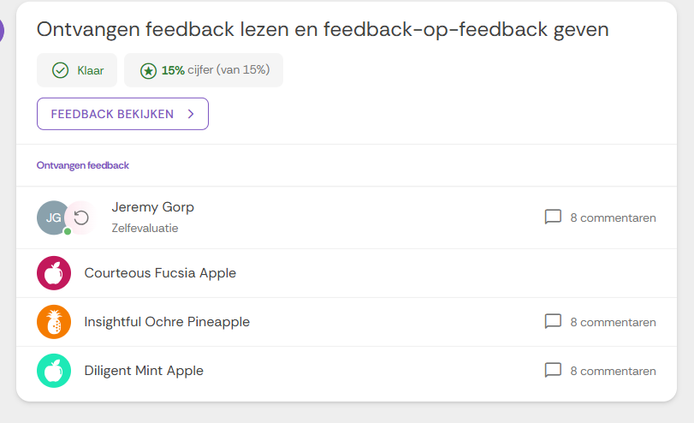
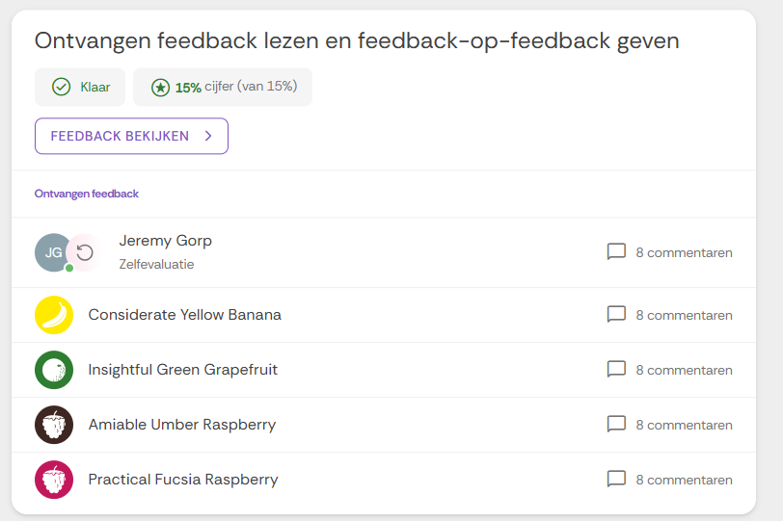
ILO 1
Professional practice
The student can collaborate (internationally) in multidisciplinary teams with different levels of knowledge in the field of data use and applications. They can set up and execute projects in collaboration with stakeholders and team members. They can act as a sounding board in discussions with team members, customers, users and experts. They strive for a good balance between input of their own vision and additional expertise of others. They are able to lead a team.
1/1
1.8
The student submits work to a professional standard.
Pre-requisites | A: 10 points
The student submits a complete learning log, work log, and self-assessment rubric. The student exhibits professional behaviour during DataLab sessions. The student obtained at least 10 points in week 9-10 challenges. | The student is able to produce and submit work that meets professional standards across various formats. Code is well-documented, adhering to best practices such as clear docstrings, compliance with style guides, and easy-to-follow documentation. Reports are structured, formal, and free from casual language, demonstrating clarity and depth. Presentations are thoughtfully designed, visually appealing, and tailored to the intended audience. Peer reviews are conducted respectfully and constructively, offering honest, actionable feedback. Worklogs and learning logs are consistently maintained, detailed, and reflective, effectively capturing daily progress, key actions, and critical insights. In all submissions, the student demonstrates attention to detail, communicates effectively, and upholds professionalism to ensure their work is clear, credible, and impactful.
I was present during almost all Datalab days. I only missed two due to dentist appointments for my wisdom teeth. Otherwise, I always showed up, and when I was sick, I informed my peers. I also completed the full learning log and the Azure dashboard, and I now have 11 points. I was initially one point short, but after retaking one challenge, I reached the full 11. | I maintained a complete and detailed learning log throughout the project, documenting daily tasks, progress, and reflections. My Azure DevOps dashboard was fully set up and consistently updated to reflect our sprint planning and task distribution. All my work—including code, documentation, and peer reviews—followed a professional tone and structure. I used clear naming conventions, added docstrings, and ensured everything was readable and maintainable. Feedback I provided to peers was constructive and focused on clarity and improvement. This consistent attention to detail and professionalism reflects my qualification for this ILO.
Provide links to: Learning log Azure Devops Boards Self-assessment rubric Learning log: https://github.com/JeremyvanGorp232189/2025_D/blob/d9a9db39da60cea5bb42ae12988fdab2de81984d/LearningLog2024-25Y2D_232189.pptx Azure: CV8 Team Sprint 1 Taskboard - Boards Self assessment: https://github.com/JeremyvanGorp232189/2025_D/blob/0fe91d618017a18725f0959ecb79bcc9e0d5cbe5/Assessment%20Rubric%20Y2D%202025%20final.xlsx | Provide Links here: 11 points
Show your best examples, do not go overboard, add in short description, you are free to alter this layout (or add slides per evidence) to suit your needs. Just be sure that it is clear.

Slide 31
ILO 2
Personal Development & Academic Practice
The student applies relevant (research) methods and techniques in combination with relevant and adequate argumentation. They can reflect on (business) processes and their role in them, both theoretically and practically, by constantly evaluating their own actions and adapting them with input from others. They can translate the result of the reflection into concrete personal learning objectives.

Slide 32
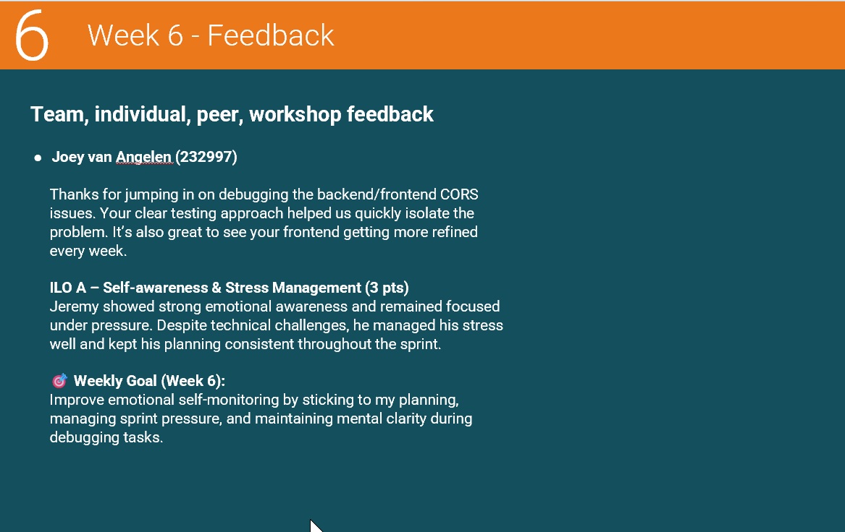
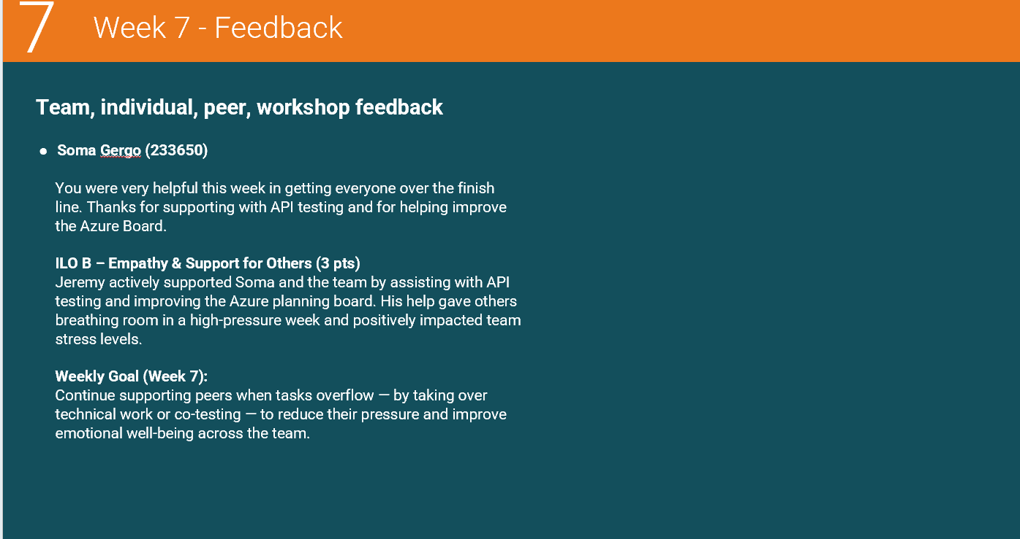
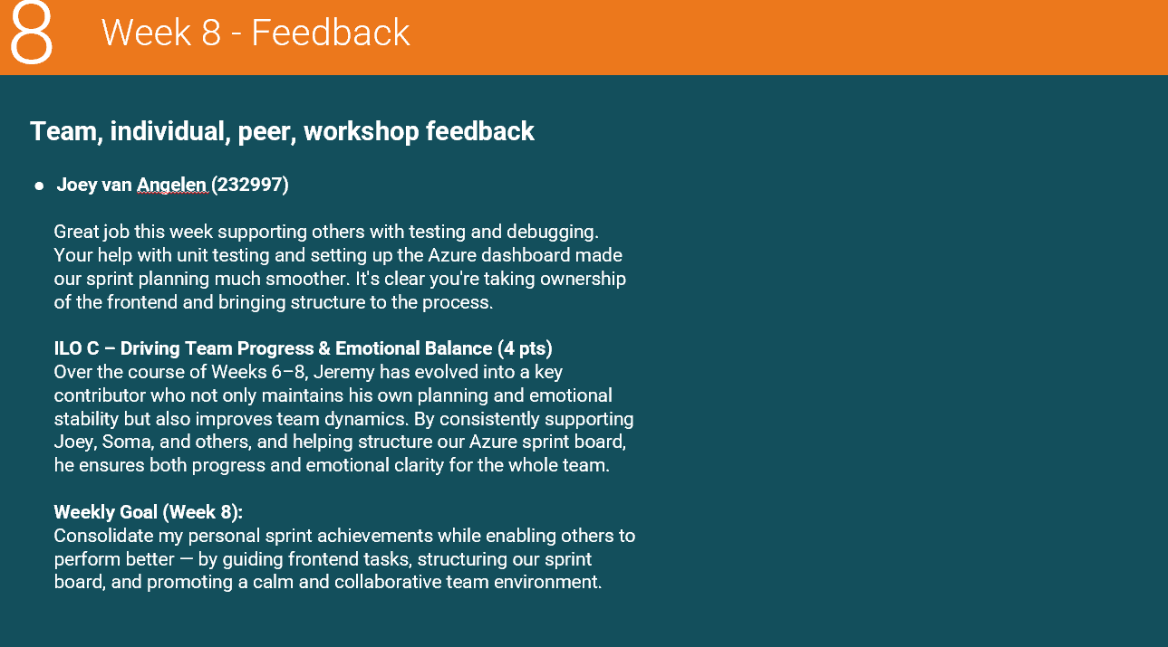
ILO 2
Personal Development & Academic Practice
The student applies relevant (research) methods and techniques in combination with relevant and adequate argumentation. They can reflect on (business) processes and their role in them, both theoretically and practically, by constantly evaluating their own actions and adapting them with input from others. They can translate the result of the reflection into concrete personal learning objectives.
1/1
2.8
The student is able to to recognize, understand, and manage their own emotions, as well as their ability to recognize, understand, and influence the emotions of others leading to considerate goal-setting and decision making and stress-management.
Pre-requisites | A: 3 points | B: 3 points | C: 4 points
The student submits a complete learning log, work log, and self-assessment rubric. The student exhibits professional behaviour during DataLab sessions. The student obtained at least 10 points in week 9-10 challenges. | The student is able to recognize, understand and manage their own emotions as evidenced by their peer review. The student is able on their capacity to self-monitor their emotions, such as stress, and create concrete action points which they actively pursue. | The student is able to recognize, understand and manage the emotions of others as evidenced by their peer review. The student is able to empathically reflect on the emotional conduct of others and provide constructive action points and support to improve the emotional conduct of other such as stress reduction. | The student is able to make appropriate decisions to further the progress of their own goals and those of others. The decisions of the student further the progress of the project and improve the quality of the team dynamics while keeping the needs and emotions of themselves and others in consideration leading to better individual, team & project outcomes.
I was present during almost all Datalab days. I only missed two due to dentist appointments for my wisdom teeth. Otherwise, I always showed up, and when I was sick, I informed my peers. I also completed the full learning log and the Azure dashboard, and I now have 11 points. I was initially one point short, but after retaking one challenge, I reached the full 11. | In Week 6, I stayed calm under pressure while debugging CORS issues. I kept my planning on track and managed stress effectively. This helped me focus, communicate clearly, and stay mentally sharp throughout the sprint. | In Week 7, I supported teammates like Soma by helping with API testing and organizing the Azure Board. This reduced their workload and stress, showing I could recognize when others needed support. | Provide a written justification explaining why you qualify for this ILO criterion. Refer to specific evidence that demonstrates how you meet the criterion. From Week 6 to 8, I helped improve sprint planning, supported debugging, and enhanced team structure. My contributions supported team goals and emotional balance, improving collaboration and workflow.
Provide links to: Learning log Azure Devops Boards Self-assessment rubric Learning log: https://github.com/JeremyvanGorp232189/2025_D/blob/d9a9db39da60cea5bb42ae12988fdab2de81984d/LearningLog2024-25Y2D_232189.pptx Azure: CV8 Team Sprint 1 Taskboard - Boards Self assessment: https://github.com/JeremyvanGorp232189/2025_D/blob/0fe91d618017a18725f0959ecb79bcc9e0d5cbe5/Assessment%20Rubric%20Y2D%202025%20final.xlsx | Provide links here: Learning log: https://github.com/JeremyvanGorp232189/2025_D/blob/d9a9db39da60cea5bb42ae12988fdab2de81984d/LearningLog2024-25Y2D_232189.pptx | Provide links here: Learning log: https://github.com/JeremyvanGorp232189/2025_D/blob/d9a9db39da60cea5bb42ae12988fdab2de81984d/LearningLog2024-25Y2D_232189.pptx | Provide links here: Learning log: https://github.com/JeremyvanGorp232189/2025_D/blob/d9a9db39da60cea5bb42ae12988fdab2de81984d/LearningLog2024-25Y2D_232189.pptx
Show your best examples, do not go overboard, add in short description, you are free to alter this layout (or add slides per evidence) to suit your needs. Just be sure that it is clear.

Slide 33
ILO 4
Problem Analysis
The student can analyse a problem by describing the context, trade-offs and formulation of the final demand (as a result of a process of demand articulation). In doing so, they identify the possible solutions. As a result, they can formulate an approach for a data trajectory considering relevant actors and interests, involving relevant theories and (technical) possibilities.

Slide 34
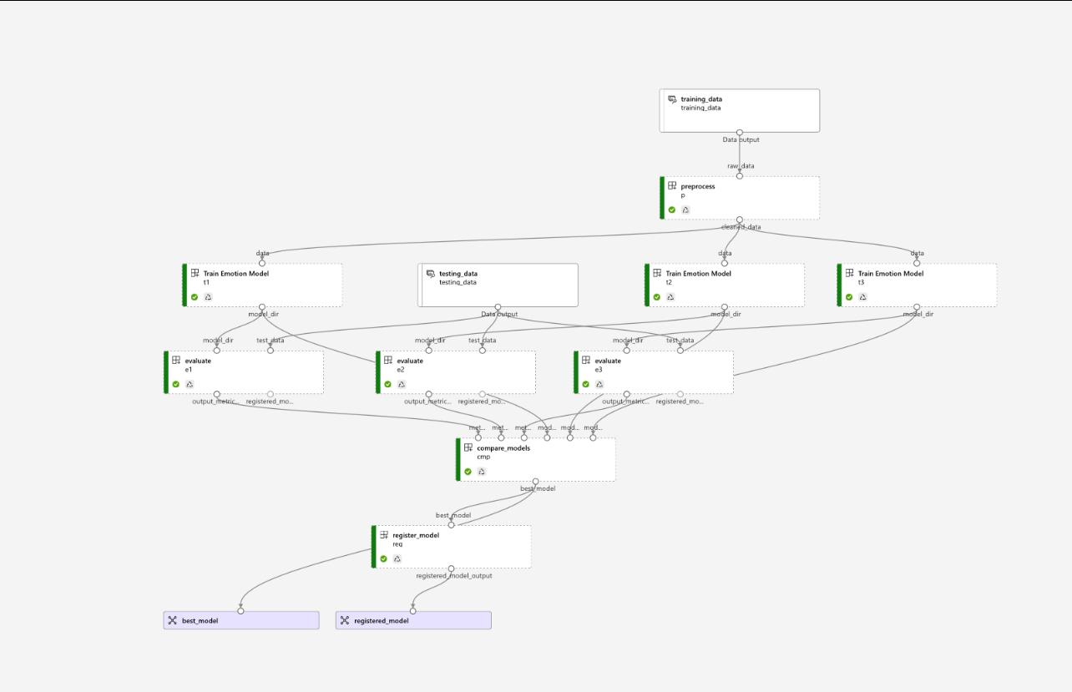
ILO 4
Problem Analysis
The The student can analyse a problem by describing the context, trade-offs and formulation of the final demand (as a result of a process of demand articulation). In doing so, they identify the possible solutions. As a result, they can formulate an approach for a data trajectory considering relevant actors and interests, involving relevant theories and (technical) possibilities.
1/1
4.4
The student is able to propose a design and plan for a ML application architecture and data pipeline and evaluating the financial costs of the application.
Pre-requisites | A: 5 points | B: 5 points
The student exhibits professional behaviour during DataLab sessions. | The student demonstrates the ability to design and plan a cloud-based ML application architecture and data pipeline that addresses the creative brief requirements. | The student demonstrates the ability to evaluate the financial costs of the proposed cloud-based ML applications, employing cost-effective resource management and monitoring strategies to balance performance and budget constraints.
I helped test the models and validate output metrics, ensuring robustness before deployment and meeting all technical and collaborative requirements. | Our team implemented a cloud-based MLOps pipeline in Azure ML using modular components: preprocess.py cleans and transforms input data. train.py and train_hpo.py train emotion classifiers with support for optimization. evaluate.py and compare.py assess model quality and select the best candidate. register.py ensures only models that meet strict quality thresholds are registered. setup_monitoring.py adds runtime observability. All dependencies and environments are defined in .yml files for reproducibility. The design balances performance, automation, and deployment reliability—meeting the standard for professional ML engineering. | We evaluated the financial costs of our cloud-based ML pipeline by comparing AzureML with our on-premise Portainer setup. As a team, we tracked GPU usage, inference costs, and deployment time to find a cost-effective balance between performance and budget. Our cost analysis document provides a detailed comparison and guided our decision to switch to a more scalable and budget-friendly solution.
Provide links to: Learning log Azure Devops Boards Self-assessment rubric Learning log: https://github.com/JeremyvanGorp232189/2025_D/blob/d9a9db39da60cea5bb42ae12988fdab2de81984d/LearningLog2024-25Y2D_232189.pptx Azure: CV8 Team Sprint 1 Taskboard - Boards Self assessment: https://github.com/JeremyvanGorp232189/2025_D/blob/0fe91d618017a18725f0959ecb79bcc9e0d5cbe5/Assessment%20Rubric%20Y2D%202025%20final.xlsx | Provide links here: Pipeline: https://github.com/BredaUniversityADSAI/2024-25d-fai2-adsai-group-nlp11/tree/dev/CV8/src/training/components Compare.py: https://github.com/BredaUniversityADSAI/2024-25d-fai2-adsai-group-nlp11/blob/e65dbc198ecca76aff7a1986aec1a0e2c187d9b7/CV8/src/training/components/compare.py Environment.yml: https://github.com/BredaUniversityADSAI/2024-25d-fai2-adsai-group-nlp11/blob/e65dbc198ecca76aff7a1986aec1a0e2c187d9b7/CV8/src/training/components/environment.yml Evaluate.py: https://github.com/BredaUniversityADSAI/2024-25d-fai2-adsai-group-nlp11/blob/e65dbc198ecca76aff7a1986aec1a0e2c187d9b7/CV8/src/training/components/evaluate.py Preprocess.py: https://github.com/BredaUniversityADSAI/2024-25d-fai2-adsai-group-nlp11/blob/e65dbc198ecca76aff7a1986aec1a0e2c187d9b7/CV8/src/training/components/preprocess.py Register.py: https://github.com/BredaUniversityADSAI/2024-25d-fai2-adsai-group-nlp11/blob/e65dbc198ecca76aff7a1986aec1a0e2c187d9b7/CV8/src/training/components/register.py Setup_monitoring.py: https://github.com/BredaUniversityADSAI/2024-25d-fai2-adsai-group-nlp11/blob/e65dbc198ecca76aff7a1986aec1a0e2c187d9b7/CV8/src/training/components/setup_monitoring.py Train.py: https://github.com/BredaUniversityADSAI/2024-25d-fai2-adsai-group-nlp11/blob/e65dbc198ecca76aff7a1986aec1a0e2c187d9b7/CV8/src/training/components/train.py Train_hpo.py: https://github.com/BredaUniversityADSAI/2024-25d-fai2-adsai-group-nlp11/blob/e65dbc198ecca76aff7a1986aec1a0e2c187d9b7/CV8/src/training/components/train_hpo.py Train_hpo.yml: https://github.com/BredaUniversityADSAI/2024-25d-fai2-adsai-group-nlp11/blob/e65dbc198ecca76aff7a1986aec1a0e2c187d9b7/CV8/src/training/components/train_hpo.yml | Provide links here: https://github.com/BredaUniversityADSAI/2024-25d-fai2-adsai-group-nlp11/blob/e65dbc198ecca76aff7a1986aec1a0e2c187d9b7/Cost_effectiveness.pdf
Show your best examples, do not go overboard, add in short description, you are free to alter this layout (or add slides per evidence) to suit your needs. Just be sure that it is clear.

Slide 35
ILO 8
Modelling
The student can apply modelling techniques including Machine Learning and AI to create value for individuals, organizations and domains.

Slide 36
ILO 8
Modelling
The student can apply modelling techniques including Machine Learning and AI to create value for individuals, organizations and domains.
1/1
8.9
The student demonstrates the ability to train machine learning models on multiple platforms both locally and in the cloud making use of appropriate resources, platforms and automation tools.
Pre-requisites | A: 4 points | B: 6 points
The student exhibits professional behaviour during DataLab sessions. Clear individual contribution to this ILO is documented. | The student demonstrates the ability to train models both locally and on an appropriate cloud platform using industry standard libraries to track key training and evaluation metrics. The student demonstrates the ability to use version control techniques and tools in the context of ML Models. | The development team creates training pipelines and works towards high levels of automation in the workflow. Hyperparameter tuning is automated as a part of the training pipeline. Appropriate use is made of pipeline scheduling. Multiple model architectures are trained and evaluated including custom and existing open-source models. Advanced automated metric logging and visualisation is incorporated, including learning curves and example outputs. The student demonstrates the ability to implement continuous retraining of a ML model.
I demonstrated professional behavior by advising the team and actively testing API outputs and metrics. My input improved latency tracking and monitoring reliability during development. | We trained and tested our models both locally and on Azure ML, using industry-standard tools such as MLflow for tracking metrics. Our pipeline folder includes modules for preprocessing, training, evaluation, and registration, all version-controlled in GitHub. I actively contributed to testing the models and validating output metrics across development phases, ensuring robustness before deployment. This demonstrates full compliance with the technical and collaborative requirements. | We developed a full deployment and monitoring pipeline using Docker, FastAPI, and Azure Container Instances. The monitoring folder contains app.py, which exposes endpoints for real-time latency checks and confidence metrics. I contributed to testing the API functionality, verifying output consistency, and ensuring smooth deployment using deploy.py. Our README.md provides endpoint documentation and sample usage, confirming adherence to cloud deployment and monitoring standards.
Provide links to: Learning log Azure Devops Boards Self-assessment rubric Learning log: https://github.com/JeremyvanGorp232189/2025_D/blob/d9a9db39da60cea5bb42ae12988fdab2de81984d/LearningLog2024-25Y2D_232189.pptx Azure: CV8 Team Sprint 1 Taskboard - Boards Self assessment: https://github.com/JeremyvanGorp232189/2025_D/blob/0fe91d618017a18725f0959ecb79bcc9e0d5cbe5/Assessment%20Rubric%20Y2D%202025%20final.xlsx | Provide links here: Pipeline folder: https://github.com/BredaUniversityADSAI/2024-25d-fai2-adsai-group-nlp11/tree/dev/CV8/src/training/components Monitoring folder: https://github.com/BredaUniversityADSAI/2024-25d-fai2-adsai-group-nlp11/tree/e65dbc198ecca76aff7a1986aec1a0e2c187d9b7/CV8/src/monitoring Readme.md: https://github.com/BredaUniversityADSAI/2024-25d-fai2-adsai-group-nlp11/blob/e65dbc198ecca76aff7a1986aec1a0e2c187d9b7/CV8/src/readme.md ============================================================ Pipeline files: Compare.py: https://github.com/BredaUniversityADSAI/2024-25d-fai2-adsai-group-nlp11/blob/e65dbc198ecca76aff7a1986aec1a0e2c187d9b7/CV8/src/training/components/compare.py Environment.yml: https://github.com/BredaUniversityADSAI/2024-25d-fai2-adsai-group-nlp11/blob/e65dbc198ecca76aff7a1986aec1a0e2c187d9b7/CV8/src/training/components/environment.yml Evaluate.py: https://github.com/BredaUniversityADSAI/2024-25d-fai2-adsai-group-nlp11/blob/e65dbc198ecca76aff7a1986aec1a0e2c187d9b7/CV8/src/training/components/evaluate.py Preprocess.py: https://github.com/BredaUniversityADSAI/2024-25d-fai2-adsai-group-nlp11/blob/e65dbc198ecca76aff7a1986aec1a0e2c187d9b7/CV8/src/training/components/preprocess.py Register.py: https://github.com/BredaUniversityADSAI/2024-25d-fai2-adsai-group-nlp11/blob/e65dbc198ecca76aff7a1986aec1a0e2c187d9b7/CV8/src/training/components/register.py Setup_monitoring.py: https://github.com/BredaUniversityADSAI/2024-25d-fai2-adsai-group-nlp11/blob/e65dbc198ecca76aff7a1986aec1a0e2c187d9b7/CV8/src/training/components/setup_monitoring.py Train.py: https://github.com/BredaUniversityADSAI/2024-25d-fai2-adsai-group-nlp11/blob/e65dbc198ecca76aff7a1986aec1a0e2c187d9b7/CV8/src/training/components/train.py Train_hpo.py: https://github.com/BredaUniversityADSAI/2024-25d-fai2-adsai-group-nlp11/blob/e65dbc198ecca76aff7a1986aec1a0e2c187d9b7/CV8/src/training/components/train_hpo.py Train_hpo.yml: https://github.com/BredaUniversityADSAI/2024-25d-fai2-adsai-group-nlp11/blob/e65dbc198ecca76aff7a1986aec1a0e2c187d9b7/CV8/src/training/components/train_hpo.yml ====================================================== Monitoring files: Dockerfile: https://github.com/BredaUniversityADSAI/2024-25d-fai2-adsai-group-nlp11/blob/e65dbc198ecca76aff7a1986aec1a0e2c187d9b7/CV8/src/monitoring/Dockerfile App.py https://github.com/BredaUniversityADSAI/2024-25d-fai2-adsai-group-nlp11/blob/e65dbc198ecca76aff7a1986aec1a0e2c187d9b7/CV8/src/monitoring/app.py Deploy.py https://github.com/BredaUniversityADSAI/2024-25d-fai2-adsai-group-nlp11/blob/e65dbc198ecca76aff7a1986aec1a0e2c187d9b7/CV8/src/monitoring/deploy.py | Provide links here: Pipeline folder: https://github.com/BredaUniversityADSAI/2024-25d-fai2-adsai-group-nlp11/tree/dev/CV8/src/training/components Monitoring folder: https://github.com/BredaUniversityADSAI/2024-25d-fai2-adsai-group-nlp11/tree/e65dbc198ecca76aff7a1986aec1a0e2c187d9b7/CV8/src/monitoring Readme.md: https://github.com/BredaUniversityADSAI/2024-25d-fai2-adsai-group-nlp11/blob/e65dbc198ecca76aff7a1986aec1a0e2c187d9b7/CV8/src/readme.md ============================================================ Pipeline files: Compare.py: https://github.com/BredaUniversityADSAI/2024-25d-fai2-adsai-group-nlp11/blob/e65dbc198ecca76aff7a1986aec1a0e2c187d9b7/CV8/src/training/components/compare.py Environment.yml: https://github.com/BredaUniversityADSAI/2024-25d-fai2-adsai-group-nlp11/blob/e65dbc198ecca76aff7a1986aec1a0e2c187d9b7/CV8/src/training/components/environment.yml Evaluate.py: https://github.com/BredaUniversityADSAI/2024-25d-fai2-adsai-group-nlp11/blob/e65dbc198ecca76aff7a1986aec1a0e2c187d9b7/CV8/src/training/components/evaluate.py Preprocess.py: https://github.com/BredaUniversityADSAI/2024-25d-fai2-adsai-group-nlp11/blob/e65dbc198ecca76aff7a1986aec1a0e2c187d9b7/CV8/src/training/components/preprocess.py Register.py: https://github.com/BredaUniversityADSAI/2024-25d-fai2-adsai-group-nlp11/blob/e65dbc198ecca76aff7a1986aec1a0e2c187d9b7/CV8/src/training/components/register.py Setup_monitoring.py: https://github.com/BredaUniversityADSAI/2024-25d-fai2-adsai-group-nlp11/blob/e65dbc198ecca76aff7a1986aec1a0e2c187d9b7/CV8/src/training/components/setup_monitoring.py Train.py: https://github.com/BredaUniversityADSAI/2024-25d-fai2-adsai-group-nlp11/blob/e65dbc198ecca76aff7a1986aec1a0e2c187d9b7/CV8/src/training/components/train.py Train_hpo.py: https://github.com/BredaUniversityADSAI/2024-25d-fai2-adsai-group-nlp11/blob/e65dbc198ecca76aff7a1986aec1a0e2c187d9b7/CV8/src/training/components/train_hpo.py Train_hpo.yml: https://github.com/BredaUniversityADSAI/2024-25d-fai2-adsai-group-nlp11/blob/e65dbc198ecca76aff7a1986aec1a0e2c187d9b7/CV8/src/training/components/train_hpo.yml ====================================================== Monitoring files: Dockerfile: https://github.com/BredaUniversityADSAI/2024-25d-fai2-adsai-group-nlp11/blob/e65dbc198ecca76aff7a1986aec1a0e2c187d9b7/CV8/src/monitoring/Dockerfile App.py https://github.com/BredaUniversityADSAI/2024-25d-fai2-adsai-group-nlp11/blob/e65dbc198ecca76aff7a1986aec1a0e2c187d9b7/CV8/src/monitoring/app.py Deploy.py https://github.com/BredaUniversityADSAI/2024-25d-fai2-adsai-group-nlp11/blob/e65dbc198ecca76aff7a1986aec1a0e2c187d9b7/CV8/src/monitoring/deploy.py
Show your best examples, do not go overboard, add in short description, you are free to alter this layout (or add slides per evidence) to suit your needs. Just be sure that it is clear.

Slide 37
ILO 9
Design, Prototyping and Implementation
The student can develop a prototype using an iterative cycle, explicitly involving stakeholders, and implement applications within an (existing) architecture.

Slide 38
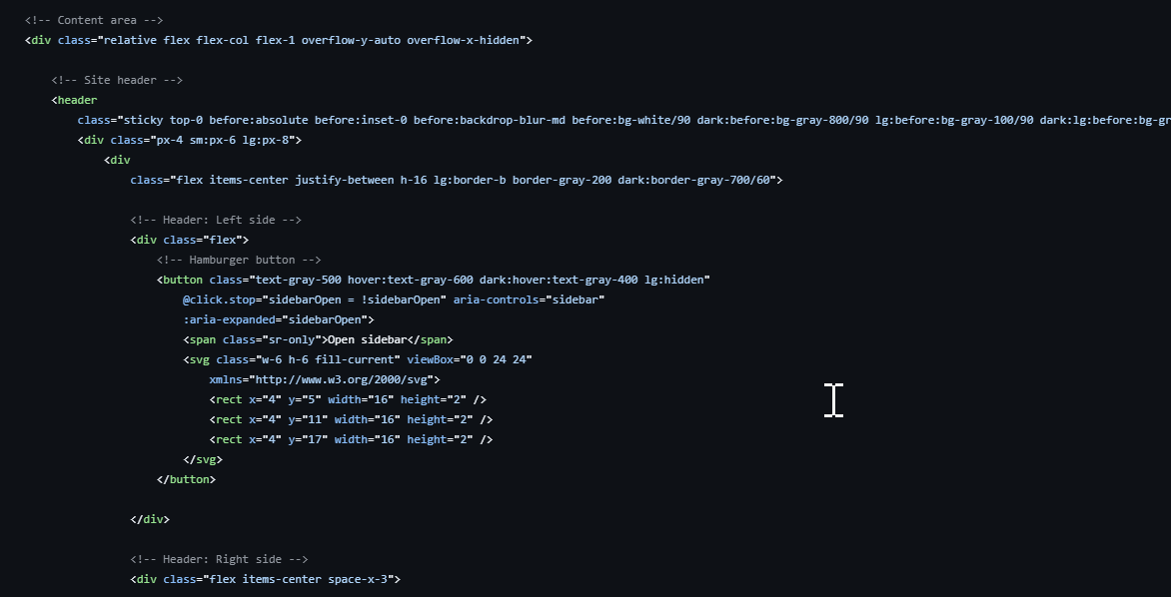
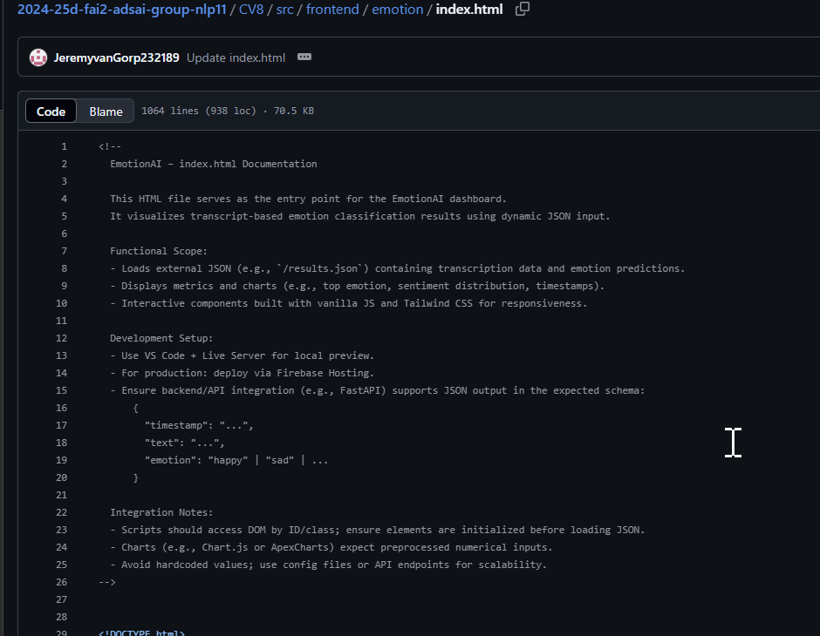
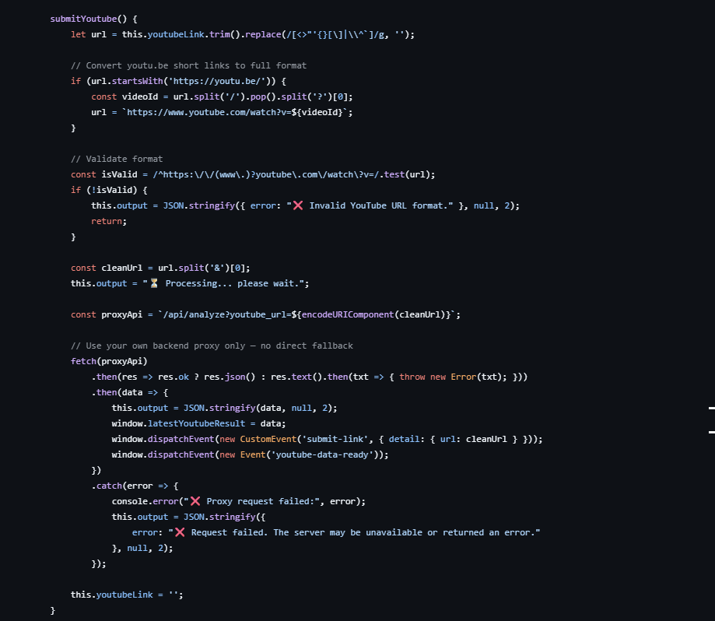
ILO 9
Design, Prototyping and Implementation
The student can develop a prototype using an iterative cycle, explicitly involving stakeholders, and implement applications within an (existing) architecture.
1/1
9.3
The student demonstrates the ability to produce high quality code that adheres to industry standards. The code is packaged in such a way that it can be used by stakeholders outside of the development environment.
Pre-requisites | A: 5 points | B: 5 points | C: 5 points
The student exhibits professional behaviour during DataLab sessions. Clear individual contribution to this ILO is documented. | The student demonstrates the ability to write production ready code that adheres to industry standards for readability, logging and error handling and documentation. Code must have function specific doc-strings that enhance clarity and usability. Code should conform to industry standard style guidelines and pass applicable linting and/or formatting checks. | The student is able to document their code in a clear and professional manner. The documentation must include detailed usage instructions, installation instructions and examples. | The student is able to create comprehensive unit tests designed to achieve coverage levels that meet client requirements and ensure code reliability. Tests are written for all key functions and modules.
I showed professional behavior during all DataLab sessions through active participation and consistent delivery. My individual work includes the full dashboard, testing notebooks, and documentation. | I ensured production-level code quality by adding detailed inline documentation at the top of index.html, clearly outlining the functional scope, integration setup, and expected JSON schema. Throughout the HTML structure, all sections are annotated for clarity. In the JavaScript logic, I implemented robust error handling with user feedback for invalid YouTube links and proxy/server failures. This ensures both usability and resilience, in line with industry standards. | I meet this criterion by providing a complete and professional README.md file that includes clear installation steps, usage instructions, example API outputs, and a structured project overview. Additionally, my index.html file contains a detailed documentation block at the top, explaining the purpose, functionality, and integration flow of the dashboard. Throughout the HTML and JavaScript code, I’ve added clear inline comments and error handling to make the logic easy to follow and maintain. This ensures my code is understandable, usable, and production-ready. | I meet this criterion by developing a structured testing suite for all major components of the EmotionAI application. The test files cover classification logic, API behavior, model training, documentation completeness, and feedback workflows. All tests use the unittest framework, with unittest.mock applied where needed to isolate dependencies. The test coverage includes: test_emotion_inference_components.ipynb – Validates the core logic of the emotion classifier, ensuring each input yields the correct predicted label. test_feedback_api.ipynb – Verifies the correct functioning of feedback submission endpoints, including edge cases and invalid input. test_main.ipynb – Runs integration-like tests on the central orchestrator script to ensure modules interact as expected. test_predictor.py – Unit tests for the standalone predictor module, focusing on correct emotion output from raw text input. test_supporting_files.ipynb – Tests helper files and configuration loading, ensuring consistent behavior across environments. test_train_full_pipeline.ipynb – Executes a full training flow with mocked data to test model training stability and data pipeline integrity. test_docs.ipynb – Checks that required documentation files exist, are properly structured, and contain valid content — ensuring the project meets professional standards. Each test includes assertions for correctness and uses mocking to isolate functionality where external calls or I/O would otherwise interfere. Together, this suite demonstrates a professional and methodical approach to testing that ensures reliability, maintainability, and client trust in the system.
Provide links to: Learning log Azure Devops Boards Self-assessment rubric Learning log: https://github.com/JeremyvanGorp232189/2025_D/blob/d9a9db39da60cea5bb42ae12988fdab2de81984d/LearningLog2024-25Y2D_232189.pptx Azure: CV8 Team Sprint 1 Taskboard - Boards Self assessment: https://github.com/JeremyvanGorp232189/2025_D/blob/0fe91d618017a18725f0959ecb79bcc9e0d5cbe5/Assessment%20Rubric%20Y2D%202025%20final.xlsx | Provide links here: Index.html: https://github.com/BredaUniversityADSAI/2024-25d-fai2-adsai-group-nlp11/blob/e65dbc198ecca76aff7a1986aec1a0e2c187d9b7/CV8/src/frontend/emotion/index.html | Provide links here: Index.html: https://github.com/BredaUniversityADSAI/2024-25d-fai2-adsai-group-nlp11/blob/e65dbc198ecca76aff7a1986aec1a0e2c187d9b7/CV8/src/frontend/emotion/index.html README.md https://github.com/BredaUniversityADSAI/2024-25d-fai2-adsai-group-nlp11/blob/8b257313cf3d29a115a566b4ac7de9dcf0c5ca32/CV8/src/frontend/emotion/README.md | Provide links here: Unit Test folder: https://github.com/BredaUniversityADSAI/2024-25d-fai2-adsai-group-nlp11/tree/ac92de7ae28bf035904a5dbea6a2b1a7736359d9/CV8/tests ========================================== Test files: Test_docs.ipynb: https://github.com/BredaUniversityADSAI/2024-25d-fai2-adsai-group-nlp11/blob/ac92de7ae28bf035904a5dbea6a2b1a7736359d9/CV8/tests/test_docs.ipynb Test_emotion_inference_components.ipynb: https://github.com/BredaUniversityADSAI/2024-25d-fai2-adsai-group-nlp11/blob/ac92de7ae28bf035904a5dbea6a2b1a7736359d9/CV8/tests/test_emotion_inference_components.ipynb Test_feedback_api.ipynb: https://github.com/BredaUniversityADSAI/2024-25d-fai2-adsai-group-nlp11/blob/ac92de7ae28bf035904a5dbea6a2b1a7736359d9/CV8/tests/test_feedback_api.ipynb Test_main.ipynb: https://github.com/BredaUniversityADSAI/2024-25d-fai2-adsai-group-nlp11/blob/ac92de7ae28bf035904a5dbea6a2b1a7736359d9/CV8/tests/test_main.ipynb Test_predictor.ipynb: https://github.com/BredaUniversityADSAI/2024-25d-fai2-adsai-group-nlp11/blob/ac92de7ae28bf035904a5dbea6a2b1a7736359d9/CV8/tests/test_predictor.py Test_supporting_files.ipynb: https://github.com/BredaUniversityADSAI/2024-25d-fai2-adsai-group-nlp11/blob/ac92de7ae28bf035904a5dbea6a2b1a7736359d9/CV8/tests/test_supporting_files.ipynb Test_train_full_pipeline.ipynb: https://github.com/BredaUniversityADSAI/2024-25d-fai2-adsai-group-nlp11/blob/ac92de7ae28bf035904a5dbea6a2b1a7736359d9/CV8/tests/test_train_full_pipeline.ipynb

Slide 39
ILO 9
Design, Prototyping and Implementation
The student can develop a prototype using an iterative cycle, explicitly involving stakeholders, and implement applications within an (existing) architecture.
1/1
9.4
The student demonstrates the ability to design and manage data solutions, including the secure storage and version control of data and implement data pipelines using industry standard tools and practices.
Pre-requisites | A: 5 points | B: 10 points
The student exhibits professional behaviour during DataLab sessions. Clear individual contribution to this ILO is documented. | The student demonstrates the ability to store data in the cloud and manage data through code. The student applies version control to data assets. | The student is able to convert data preprocessing/processing code into a data pipeline. The group is able to perform all required data preprocessing and processing steps in data pipelines using industry standard tools. The data pipelines are run on a schedule or triggered automatically based on appropriate criteria.
I worked professionally during DataLab sessions and contributed to both frontend and pipeline development. | We use version control for all code and data assets via GitHub. The entire ML pipeline, including training, preprocessing, and registration scripts, is tracked and modularized. | We developed a modular pipeline with the following components: preprocess.py: Cleans and prepares input data train.py and train_hpo.py: Handle training and hyperparameter optimization evaluate.py and compare.py: Perform automated model evaluation register.py: Pushes trained models to the Azure ML registry setup_monitoring.py: Enables logging and performance tracking Each module is integrated into a pipeline architecture triggered via YAML configuration.
Provide links to: Learning log Azure Devops Boards Self-assessment rubric Learning log: https://github.com/JeremyvanGorp232189/2025_D/blob/d9a9db39da60cea5bb42ae12988fdab2de81984d/LearningLog2024-25Y2D_232189.pptx Azure: CV8 Team Sprint 1 Taskboard - Boards Self assessment: https://github.com/JeremyvanGorp232189/2025_D/blob/0fe91d618017a18725f0959ecb79bcc9e0d5cbe5/Assessment%20Rubric%20Y2D%202025%20final.xlsx | Provide links here: Pipeline folder: https://github.com/BredaUniversityADSAI/2024-25d-fai2-adsai-group-nlp11/tree/dev/CV8/src/training/components Monitoring folder: https://github.com/BredaUniversityADSAI/2024-25d-fai2-adsai-group-nlp11/tree/e65dbc198ecca76aff7a1986aec1a0e2c187d9b7/CV8/src/monitoring Readme.md: https://github.com/BredaUniversityADSAI/2024-25d-fai2-adsai-group-nlp11/blob/e65dbc198ecca76aff7a1986aec1a0e2c187d9b7/CV8/src/readme.md ============================================================ Pipeline files: Compare.py: https://github.com/BredaUniversityADSAI/2024-25d-fai2-adsai-group-nlp11/blob/e65dbc198ecca76aff7a1986aec1a0e2c187d9b7/CV8/src/training/components/compare.py Environment.yml: https://github.com/BredaUniversityADSAI/2024-25d-fai2-adsai-group-nlp11/blob/e65dbc198ecca76aff7a1986aec1a0e2c187d9b7/CV8/src/training/components/environment.yml Evaluate.py: https://github.com/BredaUniversityADSAI/2024-25d-fai2-adsai-group-nlp11/blob/e65dbc198ecca76aff7a1986aec1a0e2c187d9b7/CV8/src/training/components/evaluate.py Preprocess.py: https://github.com/BredaUniversityADSAI/2024-25d-fai2-adsai-group-nlp11/blob/e65dbc198ecca76aff7a1986aec1a0e2c187d9b7/CV8/src/training/components/preprocess.py Register.py: https://github.com/BredaUniversityADSAI/2024-25d-fai2-adsai-group-nlp11/blob/e65dbc198ecca76aff7a1986aec1a0e2c187d9b7/CV8/src/training/components/register.py Setup_monitoring.py: https://github.com/BredaUniversityADSAI/2024-25d-fai2-adsai-group-nlp11/blob/e65dbc198ecca76aff7a1986aec1a0e2c187d9b7/CV8/src/training/components/setup_monitoring.py Train.py: https://github.com/BredaUniversityADSAI/2024-25d-fai2-adsai-group-nlp11/blob/e65dbc198ecca76aff7a1986aec1a0e2c187d9b7/CV8/src/training/components/train.py Train_hpo.py: https://github.com/BredaUniversityADSAI/2024-25d-fai2-adsai-group-nlp11/blob/e65dbc198ecca76aff7a1986aec1a0e2c187d9b7/CV8/src/training/components/train_hpo.py Train_hpo.yml: https://github.com/BredaUniversityADSAI/2024-25d-fai2-adsai-group-nlp11/blob/e65dbc198ecca76aff7a1986aec1a0e2c187d9b7/CV8/src/training/components/train_hpo.yml ====================================================== Monitoring files: Dockerfile: https://github.com/BredaUniversityADSAI/2024-25d-fai2-adsai-group-nlp11/blob/e65dbc198ecca76aff7a1986aec1a0e2c187d9b7/CV8/src/monitoring/Dockerfile App.py https://github.com/BredaUniversityADSAI/2024-25d-fai2-adsai-group-nlp11/blob/e65dbc198ecca76aff7a1986aec1a0e2c187d9b7/CV8/src/monitoring/app.py Deploy.py https://github.com/BredaUniversityADSAI/2024-25d-fai2-adsai-group-nlp11/blob/e65dbc198ecca76aff7a1986aec1a0e2c187d9b7/CV8/src/monitoring/deploy.py | Provide links here: Pipeline folder: https://github.com/BredaUniversityADSAI/2024-25d-fai2-adsai-group-nlp11/tree/dev/CV8/src/training/components Monitoring folder: https://github.com/BredaUniversityADSAI/2024-25d-fai2-adsai-group-nlp11/tree/e65dbc198ecca76aff7a1986aec1a0e2c187d9b7/CV8/src/monitoring Readme.md: https://github.com/BredaUniversityADSAI/2024-25d-fai2-adsai-group-nlp11/blob/e65dbc198ecca76aff7a1986aec1a0e2c187d9b7/CV8/src/readme.md ============================================================ Pipeline files: Compare.py: https://github.com/BredaUniversityADSAI/2024-25d-fai2-adsai-group-nlp11/blob/e65dbc198ecca76aff7a1986aec1a0e2c187d9b7/CV8/src/training/components/compare.py Environment.yml: https://github.com/BredaUniversityADSAI/2024-25d-fai2-adsai-group-nlp11/blob/e65dbc198ecca76aff7a1986aec1a0e2c187d9b7/CV8/src/training/components/environment.yml Evaluate.py: https://github.com/BredaUniversityADSAI/2024-25d-fai2-adsai-group-nlp11/blob/e65dbc198ecca76aff7a1986aec1a0e2c187d9b7/CV8/src/training/components/evaluate.py Preprocess.py: https://github.com/BredaUniversityADSAI/2024-25d-fai2-adsai-group-nlp11/blob/e65dbc198ecca76aff7a1986aec1a0e2c187d9b7/CV8/src/training/components/preprocess.py Register.py: https://github.com/BredaUniversityADSAI/2024-25d-fai2-adsai-group-nlp11/blob/e65dbc198ecca76aff7a1986aec1a0e2c187d9b7/CV8/src/training/components/register.py Setup_monitoring.py: https://github.com/BredaUniversityADSAI/2024-25d-fai2-adsai-group-nlp11/blob/e65dbc198ecca76aff7a1986aec1a0e2c187d9b7/CV8/src/training/components/setup_monitoring.py Train.py: https://github.com/BredaUniversityADSAI/2024-25d-fai2-adsai-group-nlp11/blob/e65dbc198ecca76aff7a1986aec1a0e2c187d9b7/CV8/src/training/components/train.py Train_hpo.py: https://github.com/BredaUniversityADSAI/2024-25d-fai2-adsai-group-nlp11/blob/e65dbc198ecca76aff7a1986aec1a0e2c187d9b7/CV8/src/training/components/train_hpo.py Train_hpo.yml: https://github.com/BredaUniversityADSAI/2024-25d-fai2-adsai-group-nlp11/blob/e65dbc198ecca76aff7a1986aec1a0e2c187d9b7/CV8/src/training/components/train_hpo.yml ====================================================== Monitoring files: Dockerfile: https://github.com/BredaUniversityADSAI/2024-25d-fai2-adsai-group-nlp11/blob/e65dbc198ecca76aff7a1986aec1a0e2c187d9b7/CV8/src/monitoring/Dockerfile App.py https://github.com/BredaUniversityADSAI/2024-25d-fai2-adsai-group-nlp11/blob/e65dbc198ecca76aff7a1986aec1a0e2c187d9b7/CV8/src/monitoring/app.py Deploy.py https://github.com/BredaUniversityADSAI/2024-25d-fai2-adsai-group-nlp11/blob/e65dbc198ecca76aff7a1986aec1a0e2c187d9b7/CV8/src/monitoring/deploy.py

Slide 40
ILO 9
Design, Prototyping and Implementation
The student can develop a prototype using an iterative cycle, explicitly involving stakeholders, and implement applications within an (existing) architecture.
1/1
9.5
The student demonstrates the ability to deploy and maintain machine learning solutions using industry-standard tools, integrating version control, continuous integration, automated pipelines, and monitoring practices for both local and cloud environments.
Pre-requisites | A: 5 points | B: 5 points | C: 5 points | D: 5 points
The student exhibits professional behaviour during DataLab sessions. Clear individual contribution to this ILO is documented. | The student is able to deploy an inference pipeline using industry standard tools. The student is able to interact with a deployed model locally and in the cloud. | The student is able to implement a GitHub branching strategy and automate both linting and unit tests. The deployment of the application is automated. The student is able to merge their code and ensure the tests pass. | The student is able to train models in a cloud environment and apply version control to models. The student is able to select model versions for use in the inference pipeline. The student is able to automate evaluation and model registration in a training pipeline. | The student can implement an automated machine learning retraining pipeline including automated model evaluation and deployment. Implement an appropiate monitoring solution, taking into account technical and business metrics, on the training process and the deployed models.
I consistently demonstrated professional behaviour during DataLab sessions. My main contribution focused on developing the frontend interface, including the emotion dashboard, user interaction flows, and visual integration with the backend pipeline. | We successfully deployed our emotion classification model using FastAPI, allowing both local and cloud-based interaction via RESTful endpoints. The inference pipeline is containerized and deployed Users can send audio or YouTube input, which is then transcribed and passed through the model to return classified emotions | We implemented a structured GitHub workflow with a feature-branching strategy. Pull requests are only merged after automated linting (PEP8 compliance via flake8) and unit tests have successfully passed. This ensures a clean and stable main branch. The deployment is triggered automatically via GitHub Actions upon merge, resulting in a consistent and reliable CI/CD pipeline. For example, we included test cases for the preprocessing logic and YAML parsing to validate pipeline inputs. This setup demonstrates our proficiency with DevOps principles and disciplined collaborative development. | We trained multiple model versions (baseline and optimized via HPO) in a cloud environment and registered them via Azure ML. The training is modularized (train.py, train_hpo.py) and configurable via YAML. | We built a retraining pipeline that automatically reprocesses data, retrains the model, evaluates performance, and redeploys if a better model is found. We’ve taken into account stakeholder needs by allowing batch input, error handling, and scalable hosting. This integration of retraining, monitoring, and business awareness demonstrates our capability to manage a production-grade ML lifecycle.
Provide links to: Learning log Azure Devops Boards Self-assessment rubric Learning log: https://github.com/JeremyvanGorp232189/2025_D/blob/d9a9db39da60cea5bb42ae12988fdab2de81984d/LearningLog2024-25Y2D_232189.pptx Azure: CV8 Team Sprint 1 Taskboard - Boards Self assessment: https://github.com/JeremyvanGorp232189/2025_D/blob/0fe91d618017a18725f0959ecb79bcc9e0d5cbe5/Assessment%20Rubric%20Y2D%202025%20final.xlsx | Provide links here: Pipeline: https://github.com/BredaUniversityADSAI/2024-25d-fai2-adsai-group-nlp11/tree/dev/CV8/src/training/components Monitoring folder: https://github.com/BredaUniversityADSAI/2024-25d-fai2-adsai-group-nlp11/tree/e65dbc198ecca76aff7a1986aec1a0e2c187d9b7/CV8/src/monitoring Readme.md: https://github.com/BredaUniversityADSAI/2024-25d-fai2-adsai-group-nlp11/blob/e65dbc198ecca76aff7a1986aec1a0e2c187d9b7/CV8/src/readme.md Website Github link: https://github.com/BredaUniversityADSAI/2024-25d-fai2-adsai-group-nlp11/tree/ac92de7ae28bf035904a5dbea6a2b1a7736359d9/CV8/src/frontend/emotion Website link index.html link Github: https://github.com/BredaUniversityADSAI/2024-25d-fai2-adsai-group-nlp11/blob/ac92de7ae28bf035904a5dbea6a2b1a7736359d9/CV8/src/frontend/emotion/index.html Webhost link to index-home: Emotion =========================== Pipeline files: Compare.py: https://github.com/BredaUniversityADSAI/2024-25d-fai2-adsai-group-nlp11/blob/e65dbc198ecca76aff7a1986aec1a0e2c187d9b7/CV8/src/training/components/compare.py Environment.yml: https://github.com/BredaUniversityADSAI/2024-25d-fai2-adsai-group-nlp11/blob/e65dbc198ecca76aff7a1986aec1a0e2c187d9b7/CV8/src/training/components/environment.yml Evaluate.py: https://github.com/BredaUniversityADSAI/2024-25d-fai2-adsai-group-nlp11/blob/e65dbc198ecca76aff7a1986aec1a0e2c187d9b7/CV8/src/training/components/evaluate.py Preprocess.py: https://github.com/BredaUniversityADSAI/2024-25d-fai2-adsai-group-nlp11/blob/e65dbc198ecca76aff7a1986aec1a0e2c187d9b7/CV8/src/training/components/preprocess.py Register.py: https://github.com/BredaUniversityADSAI/2024-25d-fai2-adsai-group-nlp11/blob/e65dbc198ecca76aff7a1986aec1a0e2c187d9b7/CV8/src/training/components/register.py Setup_monitoring.py: https://github.com/BredaUniversityADSAI/2024-25d-fai2-adsai-group-nlp11/blob/e65dbc198ecca76aff7a1986aec1a0e2c187d9b7/CV8/src/training/components/setup_monitoring.py Train.py: https://github.com/BredaUniversityADSAI/2024-25d-fai2-adsai-group-nlp11/blob/e65dbc198ecca76aff7a1986aec1a0e2c187d9b7/CV8/src/training/components/train.py Train_hpo.py: https://github.com/BredaUniversityADSAI/2024-25d-fai2-adsai-group-nlp11/blob/e65dbc198ecca76aff7a1986aec1a0e2c187d9b7/CV8/src/training/components/train_hpo.py Train_hpo.yml: https://github.com/BredaUniversityADSAI/2024-25d-fai2-adsai-group-nlp11/blob/e65dbc198ecca76aff7a1986aec1a0e2c187d9b7/CV8/src/training/components/train_hpo.yml ====================================================== Monitoring files: Dockerfile: https://github.com/BredaUniversityADSAI/2024-25d-fai2-adsai-group-nlp11/blob/e65dbc198ecca76aff7a1986aec1a0e2c187d9b7/CV8/src/monitoring/Dockerfile App.py https://github.com/BredaUniversityADSAI/2024-25d-fai2-adsai-group-nlp11/blob/e65dbc198ecca76aff7a1986aec1a0e2c187d9b7/CV8/src/monitoring/app.py Deploy.py https://github.com/BredaUniversityADSAI/2024-25d-fai2-adsai-group-nlp11/blob/e65dbc198ecca76aff7a1986aec1a0e2c187d9b7/CV8/src/monitoring/deploy.py | Provide links here: Pipeline: https://github.com/BredaUniversityADSAI/2024-25d-fai2-adsai-group-nlp11/tree/dev/CV8/src/training/components Unit Test folder: https://github.com/BredaUniversityADSAI/2024-25d-fai2-adsai-group-nlp11/tree/ac92de7ae28bf035904a5dbea6a2b1a7736359d9/CV8/tests Monitoring folder: https://github.com/BredaUniversityADSAI/2024-25d-fai2-adsai-group-nlp11/tree/e65dbc198ecca76aff7a1986aec1a0e2c187d9b7/CV8/src/monitoring Readme.md: https://github.com/BredaUniversityADSAI/2024-25d-fai2-adsai-group-nlp11/blob/e65dbc198ecca76aff7a1986aec1a0e2c187d9b7/CV8/src/readme.md =========================== Pipeline files: Compare.py: https://github.com/BredaUniversityADSAI/2024-25d-fai2-adsai-group-nlp11/blob/e65dbc198ecca76aff7a1986aec1a0e2c187d9b7/CV8/src/training/components/compare.py Environment.yml: https://github.com/BredaUniversityADSAI/2024-25d-fai2-adsai-group-nlp11/blob/e65dbc198ecca76aff7a1986aec1a0e2c187d9b7/CV8/src/training/components/environment.yml Evaluate.py: https://github.com/BredaUniversityADSAI/2024-25d-fai2-adsai-group-nlp11/blob/e65dbc198ecca76aff7a1986aec1a0e2c187d9b7/CV8/src/training/components/evaluate.py Preprocess.py: https://github.com/BredaUniversityADSAI/2024-25d-fai2-adsai-group-nlp11/blob/e65dbc198ecca76aff7a1986aec1a0e2c187d9b7/CV8/src/training/components/preprocess.py Register.py: https://github.com/BredaUniversityADSAI/2024-25d-fai2-adsai-group-nlp11/blob/e65dbc198ecca76aff7a1986aec1a0e2c187d9b7/CV8/src/training/components/register.py Setup_monitoring.py: https://github.com/BredaUniversityADSAI/2024-25d-fai2-adsai-group-nlp11/blob/e65dbc198ecca76aff7a1986aec1a0e2c187d9b7/CV8/src/training/components/setup_monitoring.py Train.py: https://github.com/BredaUniversityADSAI/2024-25d-fai2-adsai-group-nlp11/blob/e65dbc198ecca76aff7a1986aec1a0e2c187d9b7/CV8/src/training/components/train.py Train_hpo.py: https://github.com/BredaUniversityADSAI/2024-25d-fai2-adsai-group-nlp11/blob/e65dbc198ecca76aff7a1986aec1a0e2c187d9b7/CV8/src/training/components/train_hpo.py Train_hpo.yml: https://github.com/BredaUniversityADSAI/2024-25d-fai2-adsai-group-nlp11/blob/e65dbc198ecca76aff7a1986aec1a0e2c187d9b7/CV8/src/training/components/train_hpo.yml ========================================== Test files: Test_docs.ipynb: https://github.com/BredaUniversityADSAI/2024-25d-fai2-adsai-group-nlp11/blob/ac92de7ae28bf035904a5dbea6a2b1a7736359d9/CV8/tests/test_docs.ipynb Test_emotion_inference_components.ipynb: https://github.com/BredaUniversityADSAI/2024-25d-fai2-adsai-group-nlp11/blob/ac92de7ae28bf035904a5dbea6a2b1a7736359d9/CV8/tests/test_emotion_inference_components.ipynb Test_feedback_api.ipynb: https://github.com/BredaUniversityADSAI/2024-25d-fai2-adsai-group-nlp11/blob/ac92de7ae28bf035904a5dbea6a2b1a7736359d9/CV8/tests/test_feedback_api.ipynb Test_main.ipynb: https://github.com/BredaUniversityADSAI/2024-25d-fai2-adsai-group-nlp11/blob/ac92de7ae28bf035904a5dbea6a2b1a7736359d9/CV8/tests/test_main.ipynb Test_predictor.ipynb: https://github.com/BredaUniversityADSAI/2024-25d-fai2-adsai-group-nlp11/blob/ac92de7ae28bf035904a5dbea6a2b1a7736359d9/CV8/tests/test_predictor.py Test_supporting_files.ipynb: https://github.com/BredaUniversityADSAI/2024-25d-fai2-adsai-group-nlp11/blob/ac92de7ae28bf035904a5dbea6a2b1a7736359d9/CV8/tests/test_supporting_files.ipynb Test_train_full_pipeline.ipynb: https://github.com/BredaUniversityADSAI/2024-25d-fai2-adsai-group-nlp11/blob/ac92de7ae28bf035904a5dbea6a2b1a7736359d9/CV8/tests/test_train_full_pipeline.ipynb ====================================================== Monitoring files: Dockerfile: https://github.com/BredaUniversityADSAI/2024-25d-fai2-adsai-group-nlp11/blob/e65dbc198ecca76aff7a1986aec1a0e2c187d9b7/CV8/src/monitoring/Dockerfile App.py https://github.com/BredaUniversityADSAI/2024-25d-fai2-adsai-group-nlp11/blob/e65dbc198ecca76aff7a1986aec1a0e2c187d9b7/CV8/src/monitoring/app.py Deploy.py https://github.com/BredaUniversityADSAI/2024-25d-fai2-adsai-group-nlp11/blob/e65dbc198ecca76aff7a1986aec1a0e2c187d9b7/CV8/src/monitoring/deploy.py | Provide links here: Pipeline folder: https://github.com/BredaUniversityADSAI/2024-25d-fai2-adsai-group-nlp11/tree/dev/CV8/src/training/components Monitoring folder: https://github.com/BredaUniversityADSAI/2024-25d-fai2-adsai-group-nlp11/tree/e65dbc198ecca76aff7a1986aec1a0e2c187d9b7/CV8/src/monitoring Readme.md: https://github.com/BredaUniversityADSAI/2024-25d-fai2-adsai-group-nlp11/blob/e65dbc198ecca76aff7a1986aec1a0e2c187d9b7/CV8/src/readme.md ============================================================ Pipeline files: Compare.py: https://github.com/BredaUniversityADSAI/2024-25d-fai2-adsai-group-nlp11/blob/e65dbc198ecca76aff7a1986aec1a0e2c187d9b7/CV8/src/training/components/compare.py Environment.yml: https://github.com/BredaUniversityADSAI/2024-25d-fai2-adsai-group-nlp11/blob/e65dbc198ecca76aff7a1986aec1a0e2c187d9b7/CV8/src/training/components/environment.yml Evaluate.py: https://github.com/BredaUniversityADSAI/2024-25d-fai2-adsai-group-nlp11/blob/e65dbc198ecca76aff7a1986aec1a0e2c187d9b7/CV8/src/training/components/evaluate.py Preprocess.py: https://github.com/BredaUniversityADSAI/2024-25d-fai2-adsai-group-nlp11/blob/e65dbc198ecca76aff7a1986aec1a0e2c187d9b7/CV8/src/training/components/preprocess.py Register.py: https://github.com/BredaUniversityADSAI/2024-25d-fai2-adsai-group-nlp11/blob/e65dbc198ecca76aff7a1986aec1a0e2c187d9b7/CV8/src/training/components/register.py Setup_monitoring.py: https://github.com/BredaUniversityADSAI/2024-25d-fai2-adsai-group-nlp11/blob/e65dbc198ecca76aff7a1986aec1a0e2c187d9b7/CV8/src/training/components/setup_monitoring.py Train.py: https://github.com/BredaUniversityADSAI/2024-25d-fai2-adsai-group-nlp11/blob/e65dbc198ecca76aff7a1986aec1a0e2c187d9b7/CV8/src/training/components/train.py Train_hpo.py: https://github.com/BredaUniversityADSAI/2024-25d-fai2-adsai-group-nlp11/blob/e65dbc198ecca76aff7a1986aec1a0e2c187d9b7/CV8/src/training/components/train_hpo.py Train_hpo.yml: https://github.com/BredaUniversityADSAI/2024-25d-fai2-adsai-group-nlp11/blob/e65dbc198ecca76aff7a1986aec1a0e2c187d9b7/CV8/src/training/components/train_hpo.yml ====================================================== Monitoring files: Dockerfile: https://github.com/BredaUniversityADSAI/2024-25d-fai2-adsai-group-nlp11/blob/e65dbc198ecca76aff7a1986aec1a0e2c187d9b7/CV8/src/monitoring/Dockerfile App.py https://github.com/BredaUniversityADSAI/2024-25d-fai2-adsai-group-nlp11/blob/e65dbc198ecca76aff7a1986aec1a0e2c187d9b7/CV8/src/monitoring/app.py Deploy.py https://github.com/BredaUniversityADSAI/2024-25d-fai2-adsai-group-nlp11/blob/e65dbc198ecca76aff7a1986aec1a0e2c187d9b7/CV8/src/monitoring/deploy.py | Provide links here: Pipeline folder: https://github.com/BredaUniversityADSAI/2024-25d-fai2-adsai-group-nlp11/tree/dev/CV8/src/training/components Monitoring folder: https://github.com/BredaUniversityADSAI/2024-25d-fai2-adsai-group-nlp11/tree/e65dbc198ecca76aff7a1986aec1a0e2c187d9b7/CV8/src/monitoring Readme.md: https://github.com/BredaUniversityADSAI/2024-25d-fai2-adsai-group-nlp11/blob/e65dbc198ecca76aff7a1986aec1a0e2c187d9b7/CV8/src/readme.md ============================================================ Pipeline files: Compare.py: https://github.com/BredaUniversityADSAI/2024-25d-fai2-adsai-group-nlp11/blob/e65dbc198ecca76aff7a1986aec1a0e2c187d9b7/CV8/src/training/components/compare.py Environment.yml: https://github.com/BredaUniversityADSAI/2024-25d-fai2-adsai-group-nlp11/blob/e65dbc198ecca76aff7a1986aec1a0e2c187d9b7/CV8/src/training/components/environment.yml Evaluate.py: https://github.com/BredaUniversityADSAI/2024-25d-fai2-adsai-group-nlp11/blob/e65dbc198ecca76aff7a1986aec1a0e2c187d9b7/CV8/src/training/components/evaluate.py Preprocess.py: https://github.com/BredaUniversityADSAI/2024-25d-fai2-adsai-group-nlp11/blob/e65dbc198ecca76aff7a1986aec1a0e2c187d9b7/CV8/src/training/components/preprocess.py Register.py: https://github.com/BredaUniversityADSAI/2024-25d-fai2-adsai-group-nlp11/blob/e65dbc198ecca76aff7a1986aec1a0e2c187d9b7/CV8/src/training/components/register.py Setup_monitoring.py: https://github.com/BredaUniversityADSAI/2024-25d-fai2-adsai-group-nlp11/blob/e65dbc198ecca76aff7a1986aec1a0e2c187d9b7/CV8/src/training/components/setup_monitoring.py Train.py: https://github.com/BredaUniversityADSAI/2024-25d-fai2-adsai-group-nlp11/blob/e65dbc198ecca76aff7a1986aec1a0e2c187d9b7/CV8/src/training/components/train.py Train_hpo.py: https://github.com/BredaUniversityADSAI/2024-25d-fai2-adsai-group-nlp11/blob/e65dbc198ecca76aff7a1986aec1a0e2c187d9b7/CV8/src/training/components/train_hpo.py Train_hpo.yml: https://github.com/BredaUniversityADSAI/2024-25d-fai2-adsai-group-nlp11/blob/e65dbc198ecca76aff7a1986aec1a0e2c187d9b7/CV8/src/training/components/train_hpo.yml ====================================================== Monitoring files: Dockerfile: https://github.com/BredaUniversityADSAI/2024-25d-fai2-adsai-group-nlp11/blob/e65dbc198ecca76aff7a1986aec1a0e2c187d9b7/CV8/src/monitoring/Dockerfile App.py https://github.com/BredaUniversityADSAI/2024-25d-fai2-adsai-group-nlp11/blob/e65dbc198ecca76aff7a1986aec1a0e2c187d9b7/CV8/src/monitoring/app.py Deploy.py https://github.com/BredaUniversityADSAI/2024-25d-fai2-adsai-group-nlp11/blob/e65dbc198ecca76aff7a1986aec1a0e2c187d9b7/CV8/src/monitoring/deploy.py

Slide 41
ILO 10
Visualization
The student can apply visualization and storytelling techniques and skills to effectively and accurately inform stakeholders about (interim) results of AI and DS approaches.

Slide 42
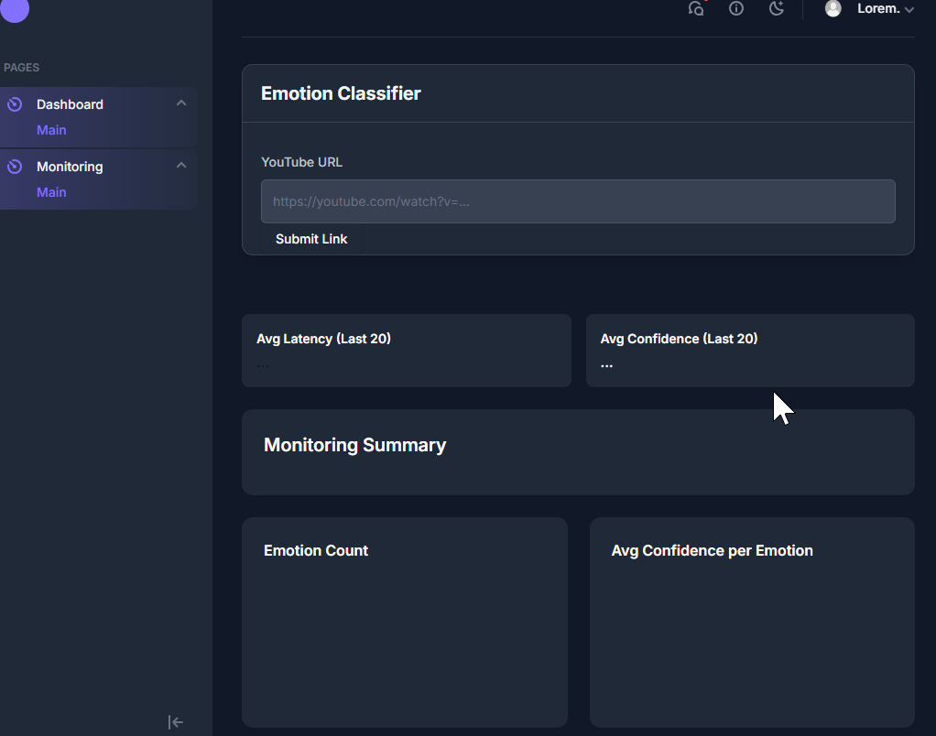
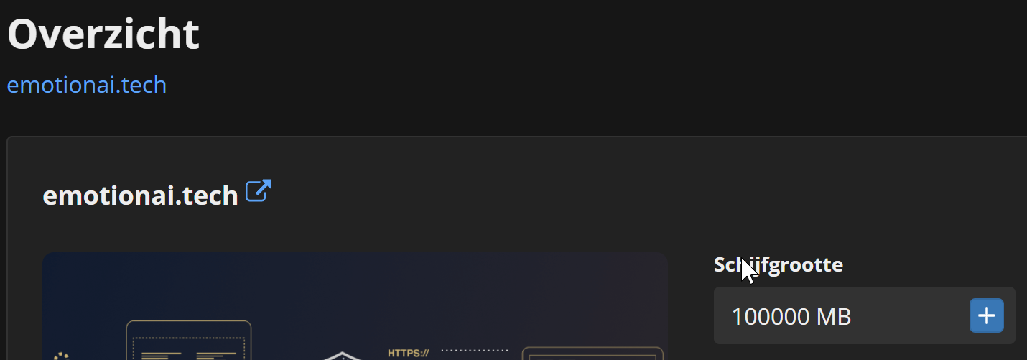
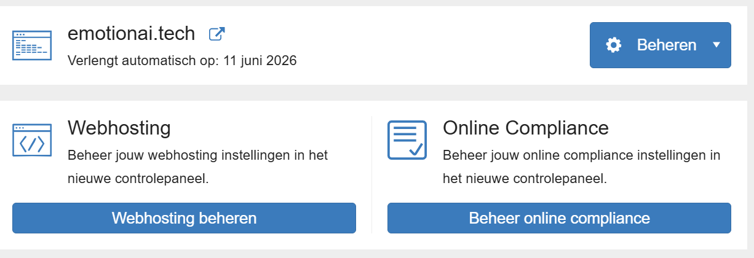
ILO 10
Visualisation
The student can apply visualization and storytelling techniques and skills to effectively and accurately inform stakeholders about (interim) results of AI and DS approaches.
1/1
10.3
The student demonstrates the ability to vizualise the project outcomes in a deployed application.
Pre-requisites | A: 4 points | B: 6 points
The student exhibits professional behaviour during DataLab sessions. Clear individual contribution to this ILO is documented. | The student demonstrates the ability to connect the deployed application to a monitoring dashboard allowing for operational and performance metrics to be monitored. Tracing is implemented to identify bottlenecks in the deployment. | The student demonstrates the ability to connect the deployed application to a user-friendly frontend in order to showcase the functionality to relevant stakeholders. Appropriate visualisations are integrated to convey business insights.
I showed professional conduct by contributing to frontend development, testing, and deployment. My individual work is clearly documented, and I actively supported teammates during DataLab sessions. | We built a dedicated monitoring.html dashboard that tracks real-time performance metrics like latency, timestamps, top emotion, and emotion frequency. These values are fetched live from the backend and visualized for operational insights. Tracing is enabled through latency logging, helping us identify and resolve bottlenecks in the deployment. | The deployed EmotionAI system is connected to a custom-built, user-friendly frontend (index.html) hosted on the domain emotionai.tech. This public-facing interface allows stakeholders to interact with the system, view live results, and understand emotion classification outcomes in a clear and structured format. Key insights such as top emotions and timestamps are presented in an intuitive layout. The responsive design ensures accessibility across devices, making the solution suitable for real-world demonstrations and stakeholder engagement.
Provide links to: Learning log Azure Devops Boards Self-assessment rubric Learning log: https://github.com/JeremyvanGorp232189/2025_D/blob/d9a9db39da60cea5bb42ae12988fdab2de81984d/LearningLog2024-25Y2D_232189.pptx Azure: CV8 Team Sprint 1 Taskboard - Boards Self assessment: https://github.com/JeremyvanGorp232189/2025_D/blob/0fe91d618017a18725f0959ecb79bcc9e0d5cbe5/Assessment%20Rubric%20Y2D%202025%20final.xlsx | Provide links here: Website Github link: https://github.com/BredaUniversityADSAI/2024-25d-fai2-adsai-group-nlp11/tree/ac92de7ae28bf035904a5dbea6a2b1a7736359d9/CV8/src/frontend/emotion Website link monitoring.html link Github: https://github.com/BredaUniversityADSAI/2024-25d-fai2-adsai-group-nlp11/blob/ac92de7ae28bf035904a5dbea6a2b1a7736359d9/CV8/src/frontend/emotion/monitoring.html Webhost link to monitor: Emotion | Provide links here: Website Github link: https://github.com/BredaUniversityADSAI/2024-25d-fai2-adsai-group-nlp11/tree/ac92de7ae28bf035904a5dbea6a2b1a7736359d9/CV8/src/frontend/emotion Website link index.html link Github: https://github.com/BredaUniversityADSAI/2024-25d-fai2-adsai-group-nlp11/blob/ac92de7ae28bf035904a5dbea6a2b1a7736359d9/CV8/src/frontend/emotion/index.html Webhost link to index-home: Emotion

Slide 43

Medal Challenges
Going the extra mile!

Slide 44
Medal Challenges
Going the extra mile!
1/1
Put your evidence down here to receive a medal!
Show your best examples, do not go overboard, add in short description, you are free to alter this layout (or add slides per evidence) to suit your needs. Just be sure that it is clear.

Slide 45
Section D
D
Reflection
Notes:
MUST BE COMPLETED IN WEEK 8
Summative reflection on your progress during the block including a critical assessment of everything you did and learned during the block. This is a comprehensive review of everything recorded in Section B, evaluated against the goals and planning laid out in Section A.

Slide 46
D
What did I achieve this block?
1/2
My most significant achievements this block
I built the full frontend of our emotion classification platform, including the live dashboard, dynamic UI components, and integration with backend APIs. It gave me confidence in my frontend development skills.
My most difficult challenges this block
Fixing the CORS handler was the most frustrating part — especially aligning frontend requests with backend security settings. Debugging this took time but made me understand cross-origin restrictions much better.
The most important lessons I learned
This block really opened my eyes to what’s possible when different components — from ML to frontend — come together.

Slide 47
D
How well am I progressing?
2/2
Reflection on my self assessment My self assessment grade is a
8.5
An 8.5 feels accurate — I delivered solid work, especially on the frontend. I contributed consistently and collaborated well with the team. The quality and scope of what I built reflects that.
How I plan to improve next block
I want to avoid getting stuck too long on the same technical issues. Sometimes, it’s better to cut corners smartly or ask for help earlier to keep momentum. I also plan to explore more backend logic and testing next time.

